Slide 1
Dabigatran in myocardial injury after noncardiac surgery
Dr. PJ Devereaux on behalf of MANAGE Investigators
Population Health Research Institute, Hamilton, Canada
Funding: Boehringer Ingelheim and Canadian Institutes of Health Research

Slide 2
Background
Myocardial injury after noncardiac surgery (MINS)
includes MI and isolated ischemic troponin elevation that occur within first 30 days after surgery
does not include non-ischemic myocardial injury
sepsis, rapid AF, PE, chronically elevated troponin
affects ≥8 million adults worldwide annually
is independently associated with increased risk of CV events and death over first 2 years after surgery
No published trial has evaluated treatment for MINS

Slide 3
Rationale for MANAGE Trial
Patients with MINS are at risk of thrombotic complications
In non-operative patients - there is high-quality evidence demonstrating benefits of anticoagulation therapy
Dabigatran oral direct thrombin inhibitor
prevents VTE in perioperative setting
In patients with MINS
dabigatran has potential to reduce broad range of vascular complications without causing substantial bleeding

Slide 4
MANAGE Trial design
RCT of patients with MINS
randomized to dabigatran or placebo
Partial 2X2 factorial design
patients not already on PPI
randomize to omeprazole or placebo
omeprazole results will be presented at later date
Investigator initiated blinded trial

Slide 5
Eligibility criteria
Included patients
≥45 yrs of age, had undergone noncardiac surgery, ≤35 days of having MINS
MINS diagnostic criteria: Universal Definition of MI or isolated ischemic troponin elevation after surgery
Excluded patients
with history of bleeding diathesis or prior intracranial, intraocular, or spinal bleeding
condition that required anticoagulation
eGFR <35 ml/min

Slide 6
Intervention and F/U
On day of randomization, patients started taking
dabigatran 110 mg BID or matching placebo
patients in partial factorial took omeprazole 20 mg daily or matching placebo
Patients took study drugs and were followed for
maximum of 2 years or until trial terminated on November 30, 2017

Slide 7
Design modification
Initial design was to randomize 3200 patient
primary composite outcome of vascular mortality and nonfatal MI, stroke, peripheral arterial thrombosis, and symptomatic PE
Recruitment slower than expected, during trial funding curtailed
Without knowledge of trial results
sample size reduced to 1750 patients - 90% power to detect HR of 0.65 (2-sided α = 0.05) assuming placebo Kaplan-Meier rate of 20%
based on COMPASS results, their relevance, and to enhance power
added amputation and symptomatic prox DVT to primary outcome

Slide 8
Outcomes
Primary efficacy outcome (major vascular complication)
composite of vascular mortality and nonfatal MI, non-hemorrhagic stroke, peripheral arterial thrombosis, amputation, and symptomatic VTE
Primary safety outcome
composite of life-threatening, major, and critical organ bleeding

Slide 9
Trial flow
1754 patients randomized to dabigatran or placebo
556 randomized to omeprazole or placebo
Patients were followed for mean of 16 months
Follow-up complete for 99% of participants

Slide 10
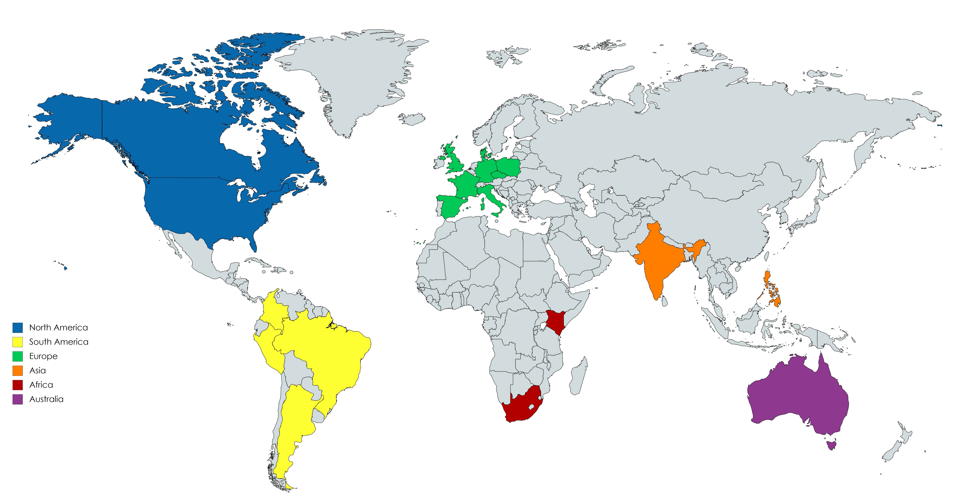
Recruitment by region 84 centres in 19 countries
765
438
268
92
4
187

Slide 11
Baseline characteristics
Characteristics | Dabigatran (N=877) | Placebo (N=877)
Age – (mean yrs) | 70 | 70
Male | 52% | 51%
MINS criteria MI isolated isch Trop elevation | 20% 80% | 20% 80%
Time from MINS diagnosis to randomization (days, IQR) | 5 (2 – 14) | 5 (2-14)
91% did not experience an ischemic symptom with MINS

Slide 12
Concomitant drug utilization any time during follow-up
Medications | Dabigatran | Placebo
Aspirin P2Y₁₂ inhibitor Aspirin or P2Y₁₂ inhibitor Dual antiplatelet therapy | 74% 7% 75% 6% | 73% 9% 75% 8%
ACEI or ARB | 59% | 59%
Beta-blocker | 47% | 45%
Statin | 69% | 69%

Slide 13
Drug compliance
Permanent study drug discontinuation
Dabigatran group 46%
Placebo group 43%
Most common reason was patient request
>55% of discontinuations

Slide 14
Primary efficacy outcome
Outcome | Dabigatran n=877 no. (%) | Placebo n=877 no. (%) | HR (95% CI) | P value
Major vascular complication | 97 (11) | 133 (15) | 0.72 (0.55-0.93) | 0.012
No significant effect of omeprazole study drug on dabigatran primary efficacy result (interaction P=0.79)

Slide 15
HR 0.72; 95% CI 0.55-0.93, P=0.012

Slide 16
Secondary efficacy outcomes
Outcome | Dabigatran n=877 no. (%) | Placebo n=877 no. (%) | HR (95% CI)
Vascular mortality All cause mortality Myocardial infarction Cardiac revascularization Peripheral arterial thrombosis Amputation Symptomatic VTE Vascular readmission Non-hemorrhagic stroke | 52 (6) 100 (11) 35 (4) 32 (4) 0 (0) 18 (2) 8 (1) 113 (13) 2 (<1) | 64 (7) 110 (13) 43 (5) 21 (2) 4 (1) 26 (3) 17 (2) 130 (15) 10 (1) | 0.80 (0.56-1.16) 0.90 (0.69-1.18) 0.80 (0.51-1.26) 1.53 (0.88-2.65) - 0.70 (0.38-1.27) 0.47 (0.20-1.08) 0.86 (0.67-1.11) 0.20 (0.04-0.90)

Slide 17
Exploratory consistency efficacy outcomes
Outcome | Dabigatran n=877 no. (%) | Placebo n=877 no. (%) | HR (95% CI)
Arterial components of primary composite outcome | 89 (10) | 121 (14) | 0.73 (0.55-0.96)
Venous components of primary composite outcome | 8 (1) | 17 (2) | 0.47 (0.20-1.08)
Original efficacy composite outcome | 81 (9) | 107 (12) | 0.74 (0.56-0.99)
Per-protocol analysis censoring 7 days after drug discontinuation | 55 (6) | 100 (11) | 0.54 (0.39-0.75)

Slide 18
Primary safety outcome
Outcome | Dabigatran n=877 no. (%) | Placebo n=877 no. (%) | HR (95% CI) | P Value
Composite of life-threatening, major, and critical organ bleed | 29 (3) | 31 (4) | 0.92 (0.55-1.53) | 0.79
No significant effect of omeprazole study drug on dabigatran primary safety result (interaction P=0.37)

Slide 19
Secondary safety outcomes
Outcome | Dabigatran n=877 no. (%) | Placebo n=877 no. (%) | HR (95% CI)
Life-threatening bleed Major bleed Critical organ bleed Intracranial bleed Hemorrhagic stroke Significant lower GI bleed Fracture Non-sign lower GI bleed Minor bleed Dyspepsia | 9 (1) 21 (2) 5 (1) 4 (1) 2 (<1) 15 (2) 39 (4) 33 (4) 134 (15) 129 (15) | 8 (1) 25 (3) 10 (1) 3 (<1) 2 (<1) 6 (1) 28 (3) 7 (1) 84 (10) 98 (11) | 1.11 (0.43-2.88) 0.83 (0.46-1.48) 0.49 (0.17-1.43) 1.32 (0.30-5.90) 0.98 (0.14-6.96) 2.50 (0.97-6.44) 1.38 (0.85-2.24) 4.77 (2.11-10.80) 1.64 (1.25-2.15) 1.33 (1.02-1.73)

Slide 20
Exploratory consistency safety outcomes
Outcome | Dabigatran n=877 no. (%) | Placebo n=877 no. (%) | HR (95% CI)
International Society of Thrombosis and Hemostasis (ISTH) major bleed | 59 (7) | 43 (5) | 1.38 (0.93-2.04)
Bleeding Academic Research Consortium (BARC) ≥Type 2 bleed | 29 (3) | 28 (3) | 1.03 (0.61-1.73)
Major upper gastrointestinal complication | 4 (1) | 4 (1) | 0.99 (0.25-3.96)
Per-protocol analysis censoring 7 days after drug discontinuation | 22 (3) | 21 (2) | 1.04 (0.57-1.88)

Slide 21
Conclusions
Among patients with MINS dabigatran 110 mg BID
decreased risk of major vascular complications
with no observed increased risk of major bleeding

Slide 22
Implications
Patients with MINS are at high risk
1 in 7 suffered major vascular complication at 16 month f/u
91% of MINS were only detected through troponin screening
clinicians will not recognize most MINS without routine perioperative troponin measurements
MANAGE demonstrated NNT of 24 patients for dabigatran to prevent major vascular complication
Potential for increased major harm substantially lower
even if assume primary safety outcome HR upper 95% CI (1.53) represents true effect NNH would be more than double (54 patients)

