Slide 1

The SECURE-PCI Trial
Statins Evaluation in Coronary procedUres and REvascularization
Otavio Berwanger, MD, PhD - On behalf of the SECURE Steering Committee and Investigators
Funding Source: Brazilian Ministry of Health (PROADI-SUS)

Slide 2
BACKGROUND
Several small studies suggested that a loading dose of statin in the periprocedural setting can reduce MACE and myocardial infarction at 30 days.
.
Most of the evidence derives from studies including patients with stable coronary disease and elective PCI.
Evidence in ACS: based on a low number of patients and events. A definitive large-scale randomized is needed in this population.

Slide 3
STUDY DESIGN
Patients with age ≥ 18 years and with ACS (STEMI, NSTEMI and UA) intended to be treated with PCI
Randomization
(Concealed)
Atorvastatin
80mg pre-procedure, followed by 80mg 24 hours after PCI
Matching Placebo
ITT
ITT
Atorvastatin 40mg/day for 30 days
Atorvastatin 40mg/day for 30 days
Primary outcome: Adjudicated MACE at 30 days (all-cause mortality, nonfatal myocardial infarction, stroke or unplanned coronary revascularization)

Slide 4


Trial Organization
Trial Steering Committee
Dr. Otávio Berwanger (Co-Chair)
Dr Renato Delascio Lopes (Co-Chair)
Dr Luiz Alberto Mattos
Dr. Alexandre Biasi Cavalcanti
Dr. Pedro G. M. de Barros e Silva
Dr. Hélio Penna Guimarães
Dr. Amanda Sousa
Dr. José Eduardo Sousa
Dr. Roberto Giraldez
Dr. Christopher B. Granger
Dr. John H. Alexander
Study Coordinating Offices
Research Institute – Heart Hospital (HCor)
Brazilian Clinical Research Institute (BCRI)
Setting: 53 Sites in Brazil

Slide 5

ELIGIBILITY
Inclusion criteria
Both genders,
Aged ≥ 18 years
Acute Coronary Syndrome intended to be treated with PCI (including those with ST segment elevation MI treated with primary angioplasty)
Key Exclusion criteria
Pregnant and breastfeeding women or women aged <45 not using effective contraceptive methods;
Previous inclusion in the study;
Refusal to sign the informed consent form (ICF);
Concurrent participation in other RCTs with hypolipemiant agents;
Drug hypersensitivity;
History of advanced liver disease;
Use of any statin at a maximum dose in the last 24 hours before PCI;
Use of any fibrate in the last 24 hours before the loading dose of the study.

Slide 6
OUTCOMES
Primary Outcome
MACE at 30 days: a composite of all-cause mortality, nonfatal myocardial infarction, nonfatal stroke, and unplanned coronary revascularization
Sample Size: 4,192 patients - control group event rate of 12.3%, 25% RRR, with 90% statistical power, and two-tailed alpha of 5%. Anticipated that 30% would not undergo PCI (-80% power in the PCI population).
Secondary Outcomes
Individual components of primary outcome over 30 days
Cardiovascular mortality at 30 days
Stent thrombosis at 30 days
Target vessel revascularization at 30 days
Coronary revascularization
* All outcomes were adjudicated by standardized criteria

Slide 7
Flow Chart
4215 Patients assessed for eligibility
24 Excluded
6 Did not meet inclusion criteria
5 Not enough time to receive first dose of study drug
1 Declined to participate
9 Other reasons
3 Unknown reasons
4191 Randomized
2087 Randomized to receive atorvastatin, 80 mg
1999 Received atorvastatin as randomized
88 Did not receive atorvastatin
1351 Underwent PCI
2104 Randomized to receive placebo
2010 Received placebo as randomized
94 Did not receive placebo
1359 Underwent PCI
14 Lost to 30-d follow-up
2 Withdrew consent
10 Lost to 30-d follow-up
2 Withdrew consent
2087 included in primary outcome analysis
2104 included in primary outcome analysis

Slide 8
BASELINE
Characteristic | Atorvastatin (n=2087) | Placebo (n=2104)
Age, mean (SD), years | 61.7 (11.3) | 61.9 (11.7)
Male sex (%) | 75.8 | 72.5
Initial Diagnosis, No.(%)
STEMI | 24.4 | 25.2
NSTEMI | 61.1 | 60.3
Unstable angina | 14.5 | 14.4
Previous use of chronic statin therapy (6 months before randomization), No.(%) | 29.2 | 28.5
Medical history, No.(%)
Hypertension | 70.7 | 71.3
Hypercholesterolemia | 36.2 | 36.3
Diabetes mellitus | 31.3 | 32.0
Tobacco use | 27.1 | 29.4
Previous MI | 16.4 | 15.2
Previous Stroke | 3.5 | 3.6
Renal Impairment | 2.9 | 3.5

Slide 9
BASELINE
Characteristic | Atorvastatin (n=2087) | Placebo (n=2104)
Initial Treatment strategy, (%)
PCI | 64.8 | 64.7
CABG | 7.8 | 8.1
Medical Management | 27.4 | 27.2
Other medical therapy, (%)
Aspirin | 90.2 | 89.6
Clopidogrel/Ticagrelor/Prasugrel | 85.1 | 84.0
Beta-blockers | 77.0 | 76.1
ACE inhibitors or ARB | 71.2 | 68.7
Time from hospital admission to PCI (hours)
Mean (SD) | 47.8 (66.6) | 45.3 (63.8)
Median (Interquartile range) | 20 (3 – 72) | 19 (3 – 64)
Time from randomization to PCI (hours)
Mean (SD) | 7.2 (88.8) | 9.1 (59.2)
Median (Interquartile range) | 3 (1 – 6) | 3 (1 – 6)

Slide 10
STUDY-DRUG ADMINISTRATION
Characteristic | Atorvastatin (n=2087) | Placebo (n=2104)
In all patients
First loading dose, (%) | 97.8 | 97.7
Second loading dose, (%) | 76.5 | 77.2
Atorvastatin 40mg at 30-days, mean (SD). | 86.0 (34.1) | 85.1 (32.1)
In patients that underwent PCI
First loading dose, (%) | 99 | 98.4
Second loading dose, (%) | 95.6 | 95.4
Atorvastatin 40mg at 30-days, mean (SD). | 94.4 (20.2) | 94.8 (19.7)
Time of study-drug administration in patients that underwent PCI, (%)
More than 12h before PCI | 3.7 | 5.6
2h to 12h before PCI | 51.7 | 50.5
Until 2h before PCI | 42.8 | 41.9
2h-4h after PCI | 0.7 | 0.4

Slide 11
CUMULATIVE INCIDENCE OF PRIMARY OUTCOME
(ALL PATIENTS)
16
Placebo
Atorvastatin
14
12
Hazard ratio 0.88 (95% CI, 0.69 - 1.11); p=0.27
10
Cumulative MACE incidence (%)
8
6
4
2
0
3
6
9
12
15
18
21
24
27
30
Time (days)
No. at risk
Placebo
2104
2010
1989
1974
1968
1963
1958
1949
1946
1935
1897
Atorvastatin
2087
2002
1987
1966
1960
1956
1949
1942
1934
1920
1893
Event rates of the combined primary outcome (all-cause mortality, acute myocardial infarction, stroke, and unplanned coronary revascularization) occurrence in all patients.

Slide 12
OUTCOMES AT 30 DAYS - ALL PATIENTS
Outcomes | Atorvastatin (n=2087) | Placebo (n=2104) | Hazard ratio | P value
 |  |  | (95% CI)
Death, (%) | 3.2 | 3.3 | 0.97 (0.69 to 1.35) | 0.84
Cardiovascular Death | 2.8 | 2.9 | 0.98 (0.68 to 1.40) | 0.90
Myocardial Infarction, (%) | 2.9 | 3.7 | 0.80 (0.57 to 1.11) | 0.18
Peri-PCI MI | 2.0 | 2.6 | 0.78 (0.52 to 1.17) | 0.23
Non-PCI related MI | 1.0 | 1.2 | 0.77 (0.43 to 1.39) | 0.39
Coronary Revascularization, (%) | 0.5 | 0.7 | 0.79 (0.36 to 1.75) | 0.57
Urgent/Target Vessel | 0.2 | 0.4 | 0.56 (0.19 to 1.67) | 0.30
Stroke, (%) | 0.5 | 0.5 | 0.92 (0.39 to 2.16) | 0.85
Stent Thrombosis, (%) | 0.3 | 0.7 | 0.47 (0.19 to 1.15) | 0.10

Slide 13
SUBGROUP ANALYSIS OF THE PRIMARY OUTCOME
Subgroup | Atorvastatin (n=2087) | Placebo (n=2104) | Hazard Ratio (95% CI) | Favors Atorvastatin | Favors Placebo | P Value for interaction
Sex
Male | 106/1581 (6.7) | 113/1525 (7.4) | 0.88 (0.66 - 1.16) |  |  | 0.96
Female | 42/506 (8.3) | 51/579 (8.8) | 0.89 (0.57 - 1.38)
Age (years)
≤ 65 | 69/1320 (5.2) | 87/1314 (6.6) | 0.80 (0.57 - 1.11) |  |  | 0.41
> 65 | 79/767 (10.3) | 77/790 (9.7) | 0.97 (0.70 - 1.35)
Type of ACS
STEMI | 45/495 (9.1) | 68/517 (13.2) | 0.66 (0.45 - 0.98) |  |  | 0.21
NSTEMI | 85/1241 (6.8) | 79/1236 (6.4) | 1.05 (0.76 - 1.46)
UA | 12/295 (4.1) | 14/296 (4.7) | 0.83 (0.36 - 1.93)
PCI
No | 54/734 (7.4) | 48/743 (6.5) | 1.36 (0.89 - 2.09) |  |  | 0.02
Yes | 94/1351 (7.0) | 116/1359 (8.5) | 0.72 (0.54 - 0.96)
Previous use of statin
No | 107/1477 (7.2) | 122/1502 (8.1) | 0.91 (0.69 - 1.20) |  |  | 0.58
Yes | 41/608 (6.7) | 42/600 (7.0) | 0.78 (0.49 - 1.24)
Type of stents (patients who underwent PCI)
At least one Drug-eluting stent | 64/1013 (6.3) | 86/1020 (8.4) | 0.68 (0.48 - 0.95) |  |  | 0.18
Bare metal only | 26/298 (8.7) | 26/311 (8.4) | 0.83 (0.47 - 1.48)
0.33
0.50
0.75
1.00
1.33
2.00
3.00

Slide 14
CUMULATIVE INCIDENCE OF PRIMARY OUTCOME
(PCI PATIENTS)
16
Placebo, PCI
Atorvastatin, PCI
14
12
Hazard ratio 0.72 (95% CI, 0.54 - 0.96); p=.02
10
Cumulative MACE incidence (%)
8
6
4
2
0
3
6
9
12
15
18
21
24
27
30
Time (days)
No. at risk
Placebo
1359
1283
1267
1259
1257
1253
1249
1247
1244
1239
1216
Atorvastatin
1351
1295
1290
1276
1273
1270
1266
1261
1254
1248
1235
The primary outcome occurrence in patients undergoing percutaneous coronary intervention (PCI)

Slide 15
OUTCOMES AT 30 DAYS- PCI PATIENTS
Outcomes | Atorvastatin (n=1351) | Placebo (n=1359) | Hazard ratio | P value
 |  |  | (95% CI)
MACE, (%) | 6.0 | 8.2 | 0.72 (0.54 to 0.96) | 0.02
Death, (%) | 2.3 | 3.2 | 0.72 (0.46 to 1.15) | 0.17
Cardiovascular Death | 2.1 | 2.7 | 0.76 (0.46 to 1.24) | 0.27
Myocardial Infarction, (%) | 3.6 | 5.2 | 0.68 (0.47 to 0.99) | 0.04
Peri-PCI MI | 3.0 | 4.0 | 0.76 (0.51 to 1.14) | 0.18
Non-PCI related MI | 0.6 | 1.4 | 0.42 (0.18 to 0.96) | 0.04
Coronary Revascularization, (%) | 0.6 | 0.9 | 0.67 (0.27 to 1.63) | 0.38
Urgent/Target Vessel | 0.2 | 0.5 | 0.43 (0.11 to 1.66) | 0.22
Stroke, (%) | 0.3 | 0.6 | 0.50 (0.15 to 1.66) | 0.26
Stent Thrombosis, (%) | 0.5 | 1.1 | 0.47 (0.19 to 1.14) | 0.10

Slide 16
CONCLUSION
Among patients with ACS and planned invasive management, periprocedural loading doses of atorvastatin did not reduce the rate of MACE at 30 days.
These findings do not support the routine use of loading doses of atorvastatin among unselected patients with ACS and intended invasive management.
However, among patients undergoing PCI, loading doses of atorvastatin seem to improve clinical outcomes and might be an attractive treatment strategy for patients with acute coronary syndromes with a high likelihood of undergoing PCI, particularly those with STEMI.

Slide 17
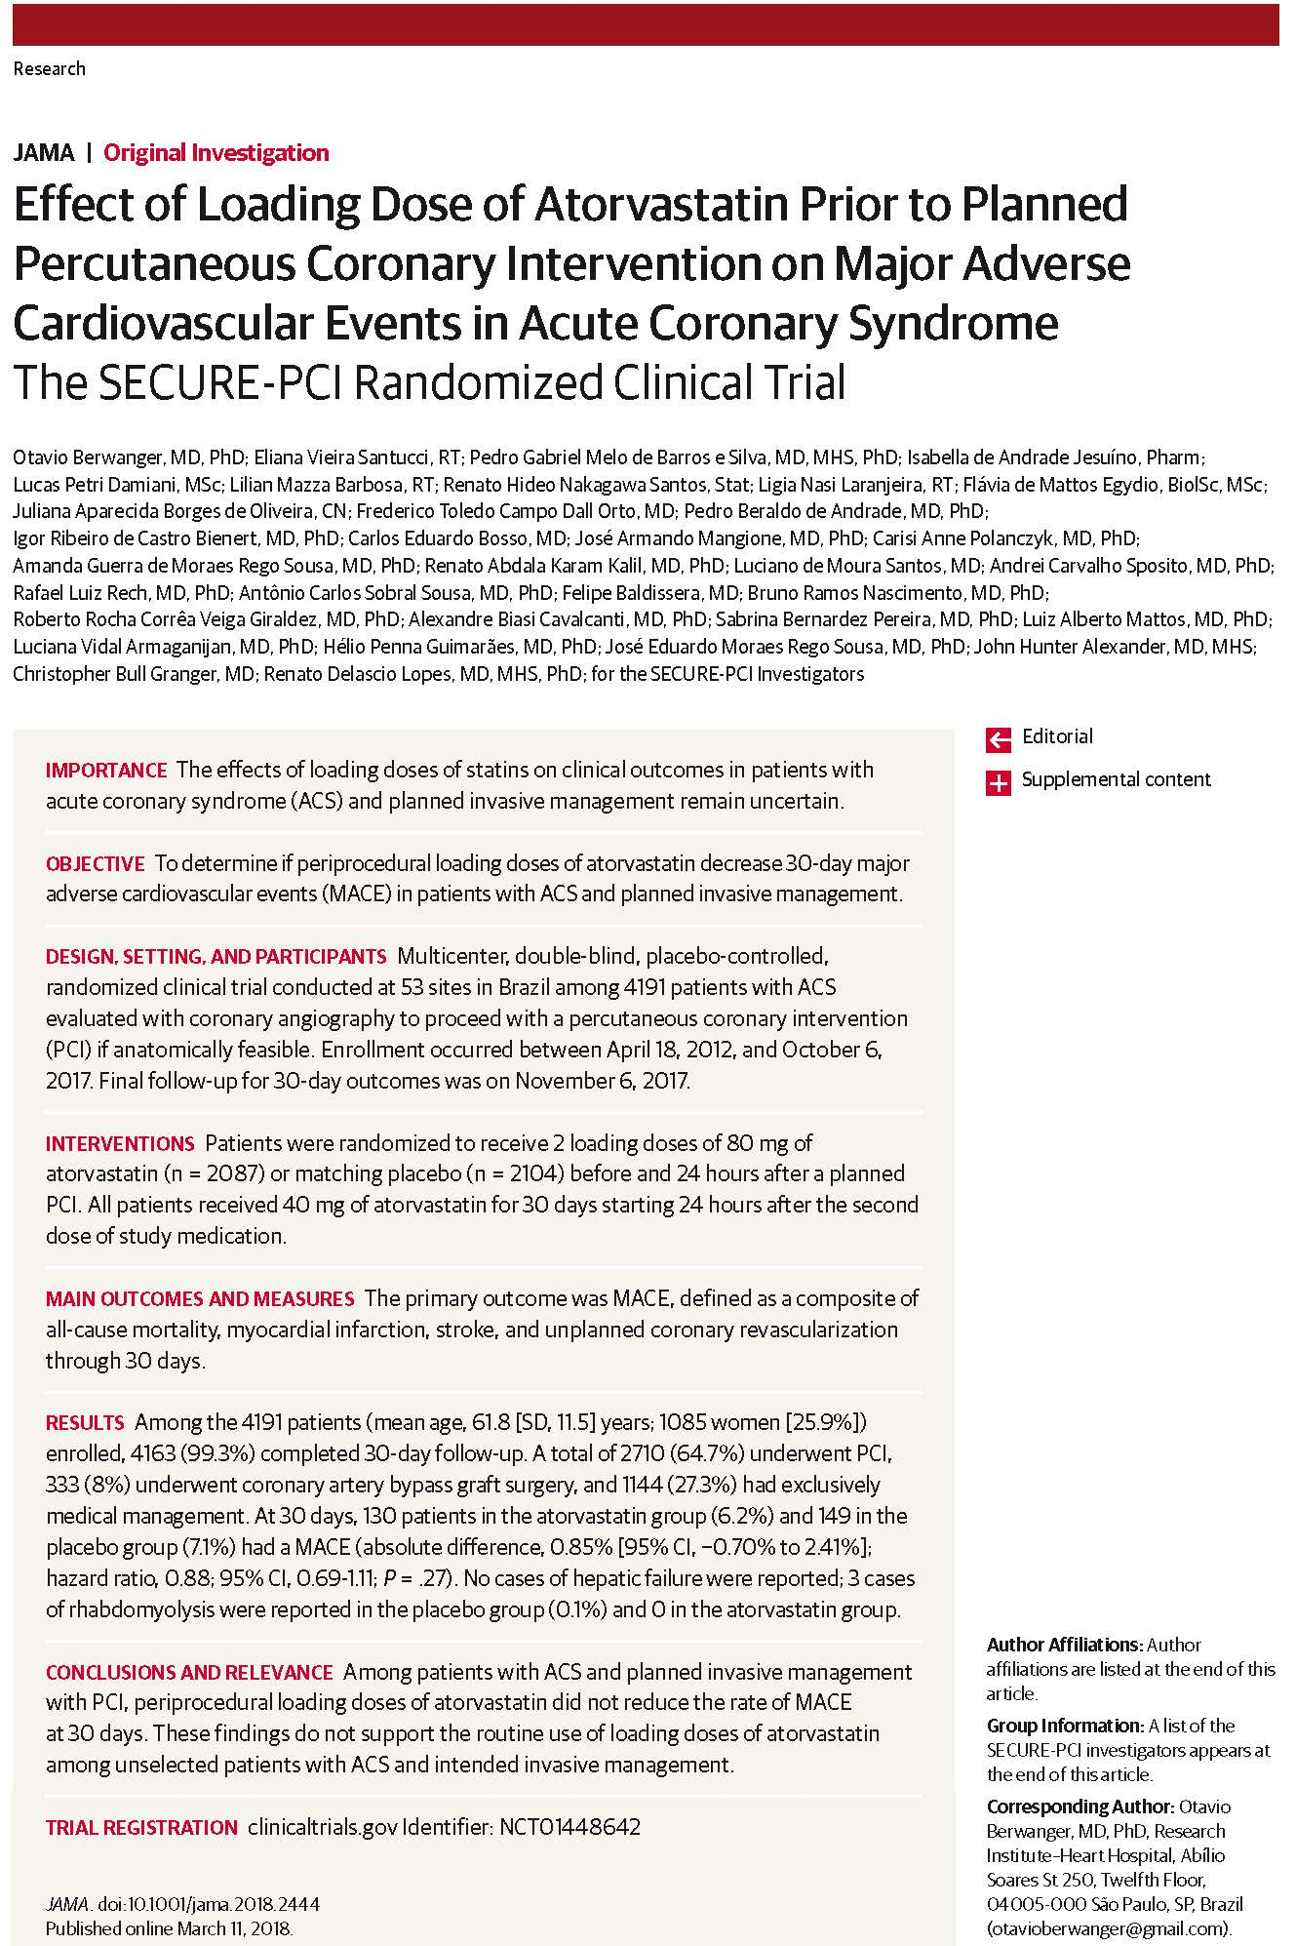
O Berwanger and coauthors
Effect of Loading Dose of Atorvastatin Prior to Planned Percutaneous Coronary Intervention on Major Adverse Cardiovascular Events in Acute Coronary Syndrome: The SECURE-PCI Randomized Clinical Trial
Published online March 11, 2018

Slide 18
CUMULATIVE INCIDENCE OF PRIMARY OUTCOME
(STEMI patients)
Placebo, Non-PCI
Atorvastatin, Non-PCI
Placebo, PCI
Atorvastatin, PCI
16
14
12
10
Cumulative MACE incidence (%)
8
6
4
PCI: Hazard ratio 0.54 (95% CI, 0.35 - 0.84); p=.01
2
Non-PCI: Hazard ratio 1.59 (95% CI, 0.63 - 4.06); p=.54
0
3
6
9
12
15
18
21
24
27
30
No. at risk
Time (days)
Placebo, Non-PCI
69
66
63
62
62
62
62
61
61
61
61
Atorvastatin, Non-PCI
78
68
65
64
64
64
64
64
64
61
60
Placebo, PCI
448
411
398
396
395
394
392
392
391
388
378
Atorvastatin, PCI
417
397
396
391
391
390
388
387
386
383
378

Slide 19
CUMULATIVE INCIDENCE OF PRIMARY OUTCOME
(NSTEMI patients)
16
Placebo, Non-PCI
Atorvastatin, Non-PCI
Placebo, PCI
Atorvastatin, PCI
14
12
10
Cumulative MACE incidence (%)
8
6
4
PCI: Hazard ratio 0.86 (95% CI, 0.57 - 1.32); p=.75
2
Non-PCI: Hazard ratio 1.46 (95% CI, 0.86 - 2.49); p=.30
0
3
6
9
12
15
18
21
24
27
30
Time (days)
No. at risk
Placebo, Non-PCI
448
436
435
432
429
429
429
424
424
422
411
Atorvastatin, Non-PCI
432
417
413
408
405
404
403
401
400
397
390
Placebo, PCI
788
757
754
749
748
745
743
741
740
738
729
Atorvastatin, PCI
809
781
777
769
766
764
763
761
756
754
747

