Slide 1
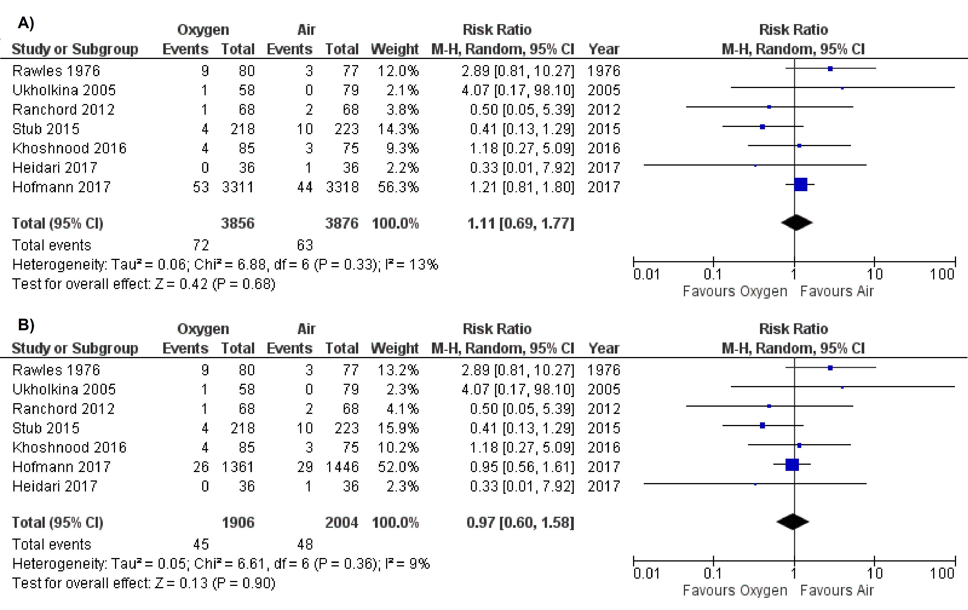
O₂ in AMI meta-analysis
Forest plot of Oxygen versus Air comparison for the outcome of in-hospital mortality in patients with A) suspected or B) confirmed AMI
Sepehrvand N, et al. Heart 2018. doi: 10.1136/heartjnl-2018-313089

Slide 2
O₂ in AMI meta-analysis
Forest plot of Oxygen versus Air comparison for the outcome of 30-day mortality (Random effect)
Sepehrvand N, et al. Heart 2018. doi: 10.1136/heartjnl-2018-313089

Slide 3
O₂ in AMI meta-analysis
Forest plot of Oxygen versus Air comparison for the outcome of cardiac troponin levels in the ITT population (Random effect)
Note: There is significant limitation to this analysis, due to significant heterogeneity around troponin assays and different sampling timepoints and clinical processes used in the included studies.
Sepehrvand N, et al. Heart 2018. doi: 10.1136/heartjnl-2018-313089

Slide 4
O₂ in AMI meta-analysis
Forest plot of Oxygen versus Air comparison for the outcome of infarct size according to CMR in the ITT population (Random effect)
Forest plot of Oxygen versus Air comparison for the outcome of hypoxemia in the ITT population (Random effect)
Sepehrvand N, et al. Heart 2018. doi: 10.1136/heartjnl-2018-313089

