Slide 1
Antithrombotic Therapy in AF patients undergoing PCI
Practical Recommendations
Dominick J. Angiolillo, MD, PhD
Professor of Medicine
Medical Director - Cardiovascular Research
Program Director – Interventional Cardiology Fellowship
University of Florida College of Medicine - Jacksonville

Slide 2
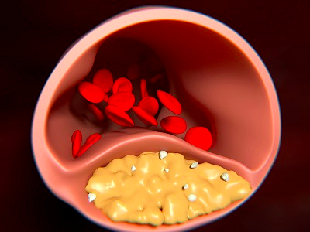
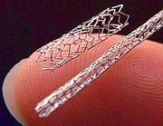
Atrial Fibrillation and PCI: Epidemiology
People in EU and US
With A-Fib
OAT indicated
Revasc. indicated
With CAD
4.8 million
20 million
16 million
1-2 million
1 billion
Capodanno D, Angiolillo DJ. Circ Cardiovasc Interv. 2014;7:113-124

Slide 3
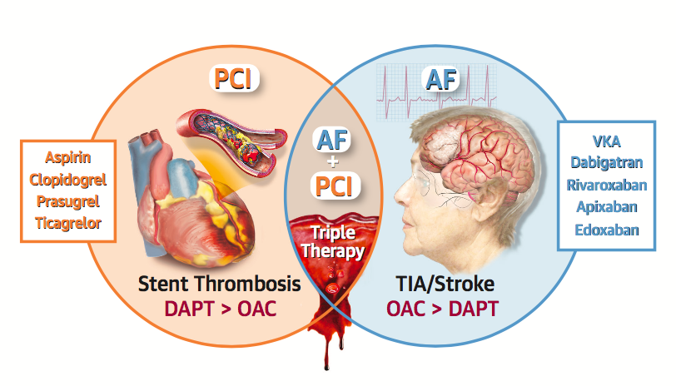
Atrial Fibrillation and PCI: Key Concepts
Stent thrombosis and coronary events
⬇
High shear stress
platelet-rich thrombi
⬇
Antiplatelet therapy
Stroke, TIA and systemic embolism
⬇
Low shear stress, less platelet-dependent thrombi
⬇
Anticoagulation therapy
Capodanno D, Angiolillo DJ. JACC Cardiovasc Interv. 2017;10:1086-1088

Slide 4
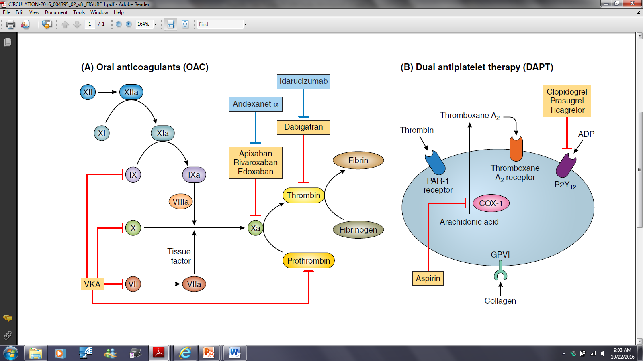
The Challenge: Discerning the choice of antithrombotic therapy
Angiolillo DJ et al. Circ Cardiovasc Interv. 2016

Slide 5
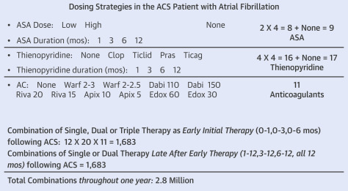
Combinations of Antiplatelet Agents and Antithrombotic Agents in Treating Patients With Atrial Fibrillation and Stent Placement
2.8 Million different combinations!!!
Gibson CM. JACC 2017; 69: 172–175

Slide 6
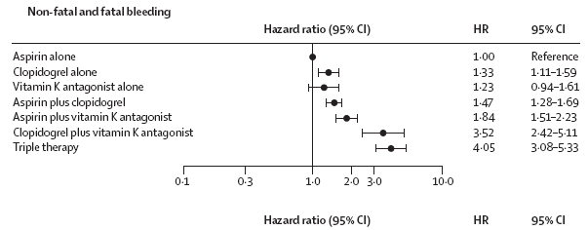
Triple therapy is associated with increased bleeding
Bleeding risk in PCI patients (n=40,812) with AMI treated with different combination of aspirin, clopidogrel and VKA
40,812 patients from Denmark admitted to hospital with first-time MI
Sorensen R, et al. Lancet. 2009;374:1967-74

Slide 7
The Challenge:
The choice of antithrombotic therapy
Which Antiplatelet?
Which Anticoagulant?

Slide 8
AF + PCI: A North American Perspective – 2018 Update
Dominick J. Angiolillo, MD, PhD, Shaun G. Goodman, MD, Deepak L. Bhatt, MD, MPH, John W. Eikelboom, MD, Matthew J. Price, MD, David J. Moliterno, MD,
Christopher P. Cannon, MD, Jean-Francois Tanguay, MD, Christopher B. Granger, MD,
Laura Mauri, MD, David R. Holmes, MD, C. Michael Gibson, MD, David P. Faxon, MD
Angiolillo DJ et al. Circulation 2018; 138:527–536.

Slide 9
The North American Perspective – 2018 Update
Management of antiplatelet therapy in patients with AF undergoing PCI treated with an OAC
Angiolillo DJ et al. Circulation 2018; 138:527–536.

Slide 10
Summary of key changes between 2016 and 2018 Expert Consensus on Antithrombotic Management of AF patients undergoing PCI
 | 2016 Expert Consensus | 2018 Expert Consensus
Choice of anticoagulant | VKA or NOAC may be both considered, with choice of agent at the discretion of the treating physician and taking into consideration patient preference | A NOAC (rather than a VKA) should generally be preferred in most patients unless contraindicated
Choice of P2Y₁₂ inhibitor | Clopidogrel is the P2Y₁₂ inhibitor of choice; avoid prasugrel or ticagrelor | Clopidogrel is the P2Y₁₂ inhibitor of choice; ticagrelor may represent a reasonable treatment option in patients at high ischemic/thrombotic and low bleeding risk; avoid prasugrel
Strategy (double vs triple therapy) | DAPT in adjunct to OAC (i.e., triple-therapy) should not extend to a full 12 months; consider SAPT (preferably clopidogrel and dropping aspirin) in adjunct to OAC (i.e., double-therapy) as early as possible (0 to 6 months post-stenting) depending on the ischemic/thrombotic and bleeding risk profile | A double-therapy regimen (OAC plus P2Y₁₂ inhibitor) immediately after hospital discharge should be considered for most patients, while extending the use of aspirin beyond hospital discharge (i.e., triple-therapy) should be considered only for patients at high ischemic/thrombotic and low bleeding risks and for a limited period of time (e.g., 1 month)
Angiolillo DJ et al. Circulation 2018; 138:527–536.

Slide 11
Why drop aspirin in AF + PCI patients on OAC?

Slide 12
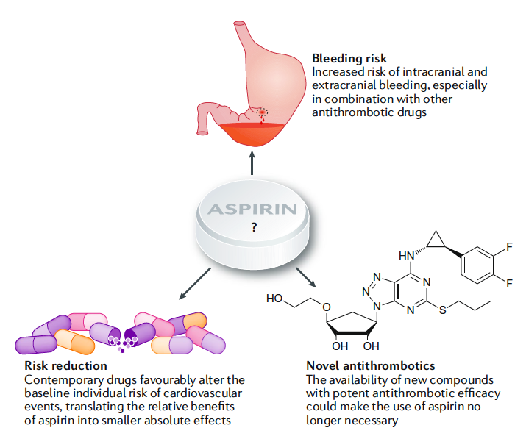
Aspirin-free Strategies in Cardiovascular Disease
Uncertainties surrounding the use of acetylsalicylic acid for secondary prevention
Three major arguments challenge the use of acetylsalicylic acid for secondary prevention in combination therapy with other antithrombotic drugs.
Capodanno D & Angiolillo DJ. Nat Rev Cardiol. 2018; 15:480-496

Slide 13
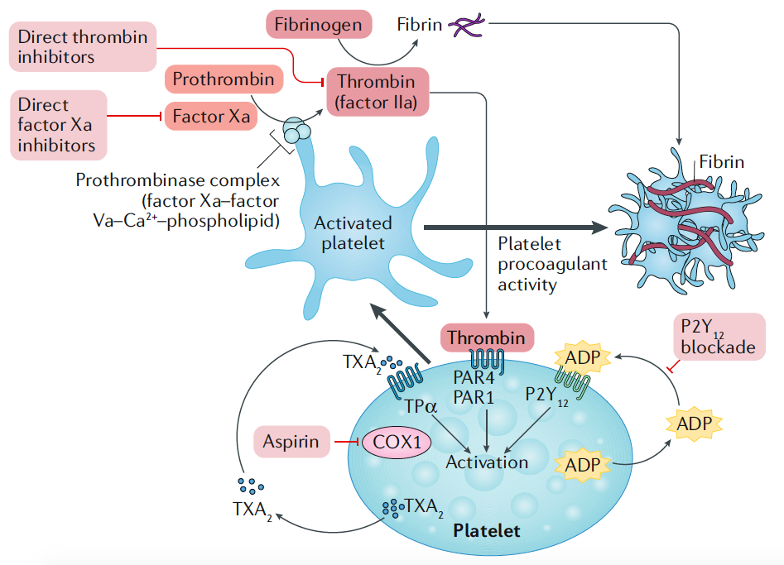
Emerging Concepts: Dual-Pathway Inhibition (DPI)
Synergy of oral anticoagulant and antiplatelet therapy
Oral anticoagulant therapy, including direct inhibitors of factor IIa and Xa, and antiplatelet agents, such as acetylsalicylic acid and P2Y₁₂ inhibitors, synergistically target two essential components of thrombosis: coagulation and platelet activation.
Capodanno D & Angiolillo DJ. Nat Rev Cardiol. 2018; 15:480-496

Slide 14
Rivaroxaban works synergistically with antiplatelet agents to reduce platelet activation: Evidence from preclinical studies
Effects of rivaroxaban, ticagrelor and their combination on IPA in human PRP
Ticagrelor, µg/ml | Inhibition of platelet aggregation, % (mean ± standard error of the mean)
 | Rivaroxaban, ng/ml
 | 0 | 15 | 30
0 | – | 20±11 | 37±11
1 | 17±6 | 52±11 | 90±4
3 | 31±8 | 76±4 | 90±6
Combination of low-dose rivaroxaban with an antiplatelet agent enhances antithrombotic potency
Perzborn E et al, J Cardiovasc Pharmacol Ther 2015;20:554–562

Slide 15
Rivaroxaban works synergistically with antiplatelet agents to reduce platelet activation: Evidence from preclinical studies
Effects of rivaroxaban, aspirin, clopidogrel and their combination
on porcine model of thrombus mass
79%
86%
98%
Thrombus mass (mg)
***
***
***
Vehicle control
ASA + clopidogrel
Rivaroxaban + ASA
Rivaroxaban ASA + clopidogrel
n=7
n=6
n=6
n=7
Rivaroxaban dose: 1 µg/kg/min.
Error bars are the standard error of the mean.
***P<0.001 (unpaired t-test vs representative vehicle group).
Becker, et al. Eur Heart J (2010) 31 doi:10.1093/eurheartj/ehq290
Porcine Model

Slide 16
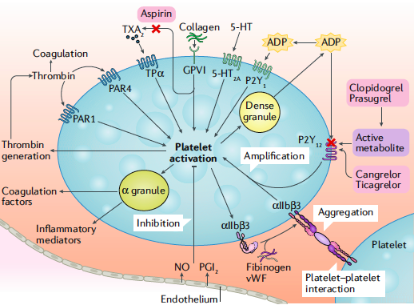
Why drop aspirin in AF + PCI patients on OAC?
pivotal role of P2Y₁₂-mediated signaling on thrombotic & inflammatory processes
established clinical efficacy of P2Y₁₂ inhibitors to reduce stent thrombosis
Platelet activation mechanisms:
P2Y₁₂ has a major role in the amplification of platelet activation via interplay with other signaling pathways, including the GP IIb/IIIa receptor
Storey RF et al. Curr Pharm Des 2006; 12:1255 -59
Capodanno D & Angiolillo DJ. Nat Rev Cardiol. 2018; 15:480-496
Angiolillo DJ et al. Circ Cardiovasc Interv. 2016;9(11). pii: e004395

Slide 17
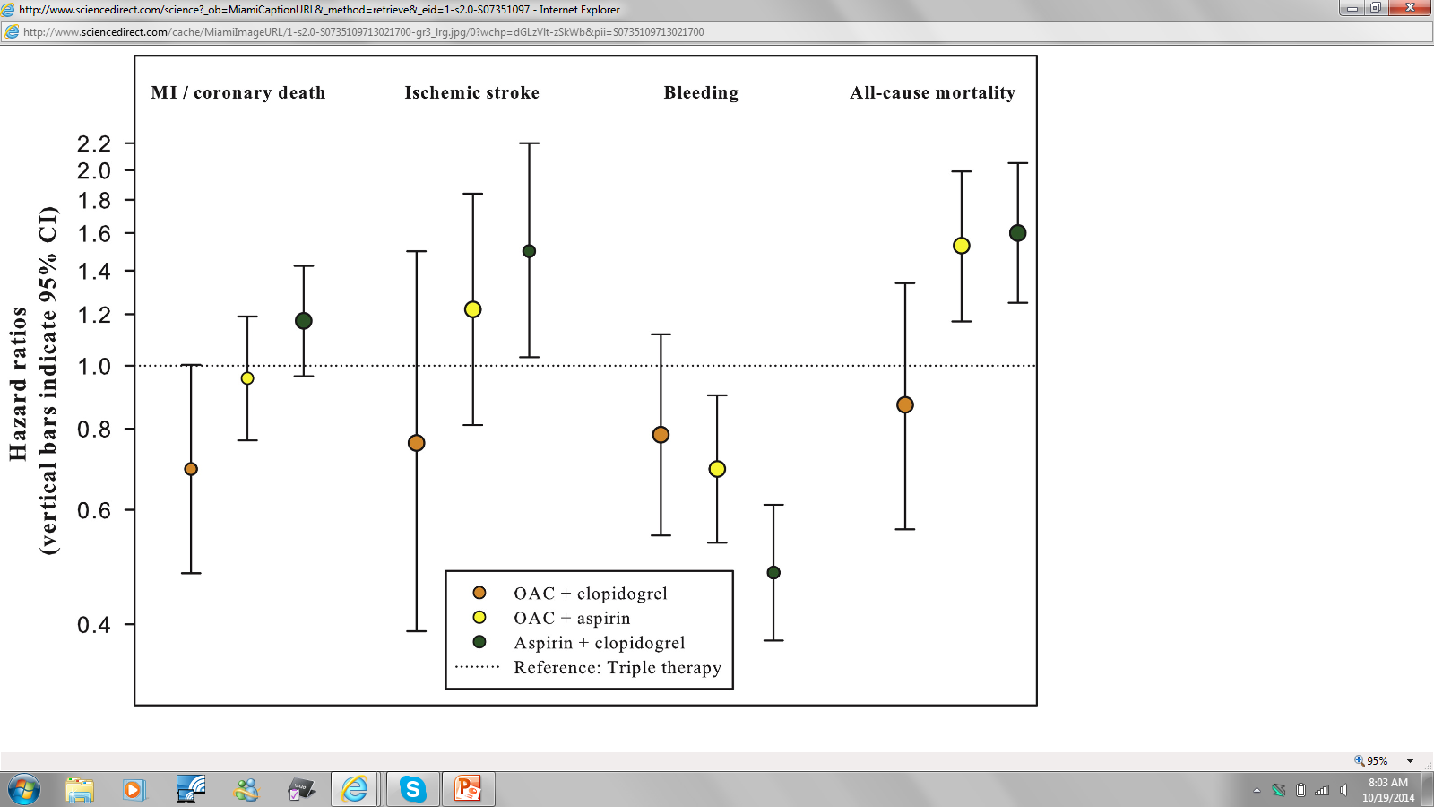
Benefit and Safety With Triple Therapy Versus Dual Therapies
Although bleeding risk with OAC + clopidogrel is higher than OAC + aspirin, the combination of OAC + clopidogrel is comparable to triple therapy in respect to the prevention of ischemic stroke, with a trend towards benefit of MI/coronary death; moreover, the risk of all-cause mortality is similar between OAC + clopidogrel and triple therapy but markedly increased for OAC + aspirin
Lamberts et al. JACC 2013; 62: 981 - 989

Slide 18
Meta-analysis of RCT of aspirin withdrawal in AF+PCI
Safety: Major & Minor Bleeding
Efficacy: Major Adverse Cardiovascular Events
Piccini JP, Jones WS. N Engl J Med. 2017;377:1580-158

Slide 19
Dual vs. Triple Antithrombotic therapy Meta-analysis of WOEST, ISAR-TRIPLE, PIONEER AF, RE-DUAL (N=5,317)
Outcome
Meta-Analytic Estimates
HR (95% CrI)
Favors dual therapy
Favors triple therapy
Any TIMI Bleeding
0.53 (0.36, 0.85)
Intracranial Bleeding
0.58 (0.23, 1.49)
Trial-Defined MACE
0.85 (0.48, 1.29)
Cardiac death
0.89 (0.41, 1.54)
All-cause mortality
0.85 (0.46, 1.37)
Myocardial infarction
1.07 (0.58, 1.95)
Stent thrombosis
1.00 (0.32, 2.82)
Stroke
0.94 (0.45, 1.84)
0
0.5
1
1.5
2
2.5
3
Hazard Ratio (95% Credible Interval)
Golwala HB, et al. Eur Heart J. 2018;39:1726-1735

Slide 20
Why prefer a NOAC over a VKA in AF + PCI patients?

Slide 21
Summary of randomized trials of NOACs vs VKA in AF patients with atrial fibrillation
 | Dabigatran |  | Rivaroxaban | Apixaban | Edoxaban
Mechanism of action | Direct thrombin inhibitor |  | Anti-factor Xa inhibitor | Anti-factor Xa Inhibitor | Anti-factor Xa Inhibitor
Clinical trial acronym | RE-LY |  | ROCKET-AF | ARISTOTLE | ENGAGE-AF
CHADS₂ (mean) | 2.1 |  | 3.5 | 2.1 | 2.8
TTR, % (median) | 67% |  | 58% | 66% | 68%
Approved dose | 150mg twice-daily* | 110mg Twice-daily* | 20mg once-daily (15mg once-daily in selected patients†) | 5mg twice-daily (2.5mg twice daily in selected patients†) | 60mg once daily (30mg once-daily in selected patients†)‡
Stroke or systemic embolism | 0.66 (0.53-0.82) | 0.91 (0.74-1.11) | 0.88 (0.74-1.03) | 0.79 (0.66-0.95) | 0.87 (0.73-1.04)
Ischemic stroke | 0.76 (0.60-0.98) | 1.11 (0.89–1.40) | 0.94 (0.75-1.17) | 0.92 (0.74-1.13) | 1.00 (0.83-1.19)
Hemorrhagic stroke | 0.26 (0.14-0.49) | 0.31 (0.17–0.56) | 0.59 (0.37-0.93) | 0.51 (0.35-0.75) | 0.54 (0.38-0.77)
All-cause mortality | 0.88 (0.77-1.00) | 0.91 (0.80–1.03) | 0.85 (0.70-1.02) | 0.89 (0.80-0.998) | 0.92 (0.83-1.01)
Major bleed | 0.93 (0.81-1.07) | 0.80 (0.69–0.93) | 1.04 (0.90-1.20) | 0.69 (0.60-0.80) | 0.80 (0.71-0.91)
Gastrointestinal bleeding | 1.50 (1.19-1.89) | 1.10 (0.86–1.41) | 1.39 (1.19-1.61) | 0.89 (0.70-1.15) | 1.23 (1.02-1.50)
Angiolillo DJ et al. Circulation 2018; 138:527–536.

Slide 22
Novel Oral Anticoagulants in AF
Risk Ratio (95% CI)
Ischemic Stroke
0.92 (0.83 - 1.02)
p=0.10
Hemorrhagic Stroke
0.49 (0.38 - 0.64)
p<0.0001
Myocardial Infarction
0.97 (0.78 - 1.20)
p=0.77
All-Cause Mortality
0.90 (0.85 - 0.95)
p=0.0003
0.2
0.5
1
2
Favors NOAC
Favors Warfarin
Heterogeneity p=NS for all outcomes
Ruff CT, et al. Lancet 2014;383:955-962

Slide 23
Use of Antiplatelets Drugs in AF Trials of NOACs
Percentages refers to use of antiplatelet drugs at some time during the study period, including discontinuation at enrollment and non-consecutive use
 | RE-LY Dabigatran | ROCKET-AF Rivaroxaban | ARISTOTLE Apixaban | ENGAGE Edoxaban
Concomitant use of aspirin alone | 32% | ≈37% | ≈31% | ≈29%
Concomitant use of clopidogrel alone | ≈2% | <2% | ≈2% | ≈2%
Concomitant use of DAPT | ≈5% | Excluded | Excluded | Excluded

Slide 24
Trials of NOACs in AF patients undergoing PCI
Dual therapy with a NOAC and P2Y12 inhibitor (dropping aspirin) wins against triple therapy
(VKA, aspirin and P2Y12 inhibitor)
Angiolillo DJ et al. Circ Cardiovasc Interv. 2016

Slide 25
Summary of the PIONEER AF-PCI and REDUAL-PCI trials
Trial | Patient Population | Indication for PCI | Primary Safety Endpoint | Secondary Efficacy Endpoint |  | Treatment Arms and Outcomes
RE-DUAL PCI | AF with PCI and stent (DES 82.6%) CrCL>30ml/min No major bleed within 1m No stroke within 1m N=2725 | ACS 50.5% | ISTH major or clinically relevant non-major bleeding | Death, MI, stroke, SE, or unplanned revascularization |  | Warfarin with ASA¹ and P2Y₁₂ inhibitor² | Dabigatran 110mg bid and P2Y₁₂ inhibitor² | Dabigatran 150mg³ bid and P2Y₁₂ inhibitor²
 |  |  |  |  | Safety | 26.9% | 15.4% | 20.2% | P<0.001 for D110 vs W P=0.002 for D150 vs W
 |  |  |  |  | Efficacy | 13.4% | 15.2% | 11.8% | P=0.005 (NI) for D combined vs. W P=0.30 for D110 vs W P=0.44 for D150 vs.W⁶
PIONEER AF-PCI | AF with PCI and stent (DES 66.1%) CrCl >30ml/min No major bleed within 1m No GI bleed within 12m No prior stroke or TIA N=2124 | ACS 51.6% | Any clinically significant bleeding | CV death, MI, stroke |  | Warfarin with ASA and P2Y₁₂ inhibitor⁴ | Rivaroxaban 2.5mg bid with ASA and P2Y₁₂ inhibitor⁴ | Rivaroxaban 15mg daily⁵ and P2Y₁₂ inhibitor⁴ | P<0.001 for R2.5 vs W P<0.001 for R15 vs W
 |  |  |  |  | Safety | 26.7% | 18.0% | 16.8% | P<0.001 for R2.5 vs W P<0.001 for R15 vs W
 |  |  |  |  | Efficacy | 6.0% | 5.6% | 6.5% | P=0.75 for R15 vs W P=0.76 for R2.5 vs W
Angiolillo DJ et al. Circulation 2018; 138:527–536.

Slide 26
Pre-Randomization Choice of Duration of DAPT & Thienopyridine: PIONEER AF-PCI
XARELTO® 15 mg qd* Clopi 95%, Ticag 4%, Prasugrel 1%
WOEST Like
R
A
N
D
O
M
I
Z
E
2100 patients with NVAF
Coronary stenting
No prior stroke/TIA, GI bleeding, Hb<10, CrCl<30
1 mo: 16%
6 mos: 35%
12 mos: 49%
≤ 72 hours
After
Sheath
removal
XARELTO® 2.5 mg bid Clopi 95%, Ticag 4%, Prasugrel 1%
Aspirin 75-100 mg qd‡
XARELTO® 15mg QD
Aspirin 75-100 mg qd
ATLAS Like
1 mo: 16%
6 mos: 35%
12 mos: 49%
VKA (target INR 2.0-3.0) Clopi 95%, Ticag 4%, Prasugrel 1%
Aspirin 75-100 mg qd
VKA (target INR 2.0-3.0) Aspirin 75-100 mg qd
TTR 65%
Triple
Therapy
Gibson et al. AHA 2016

Slide 27
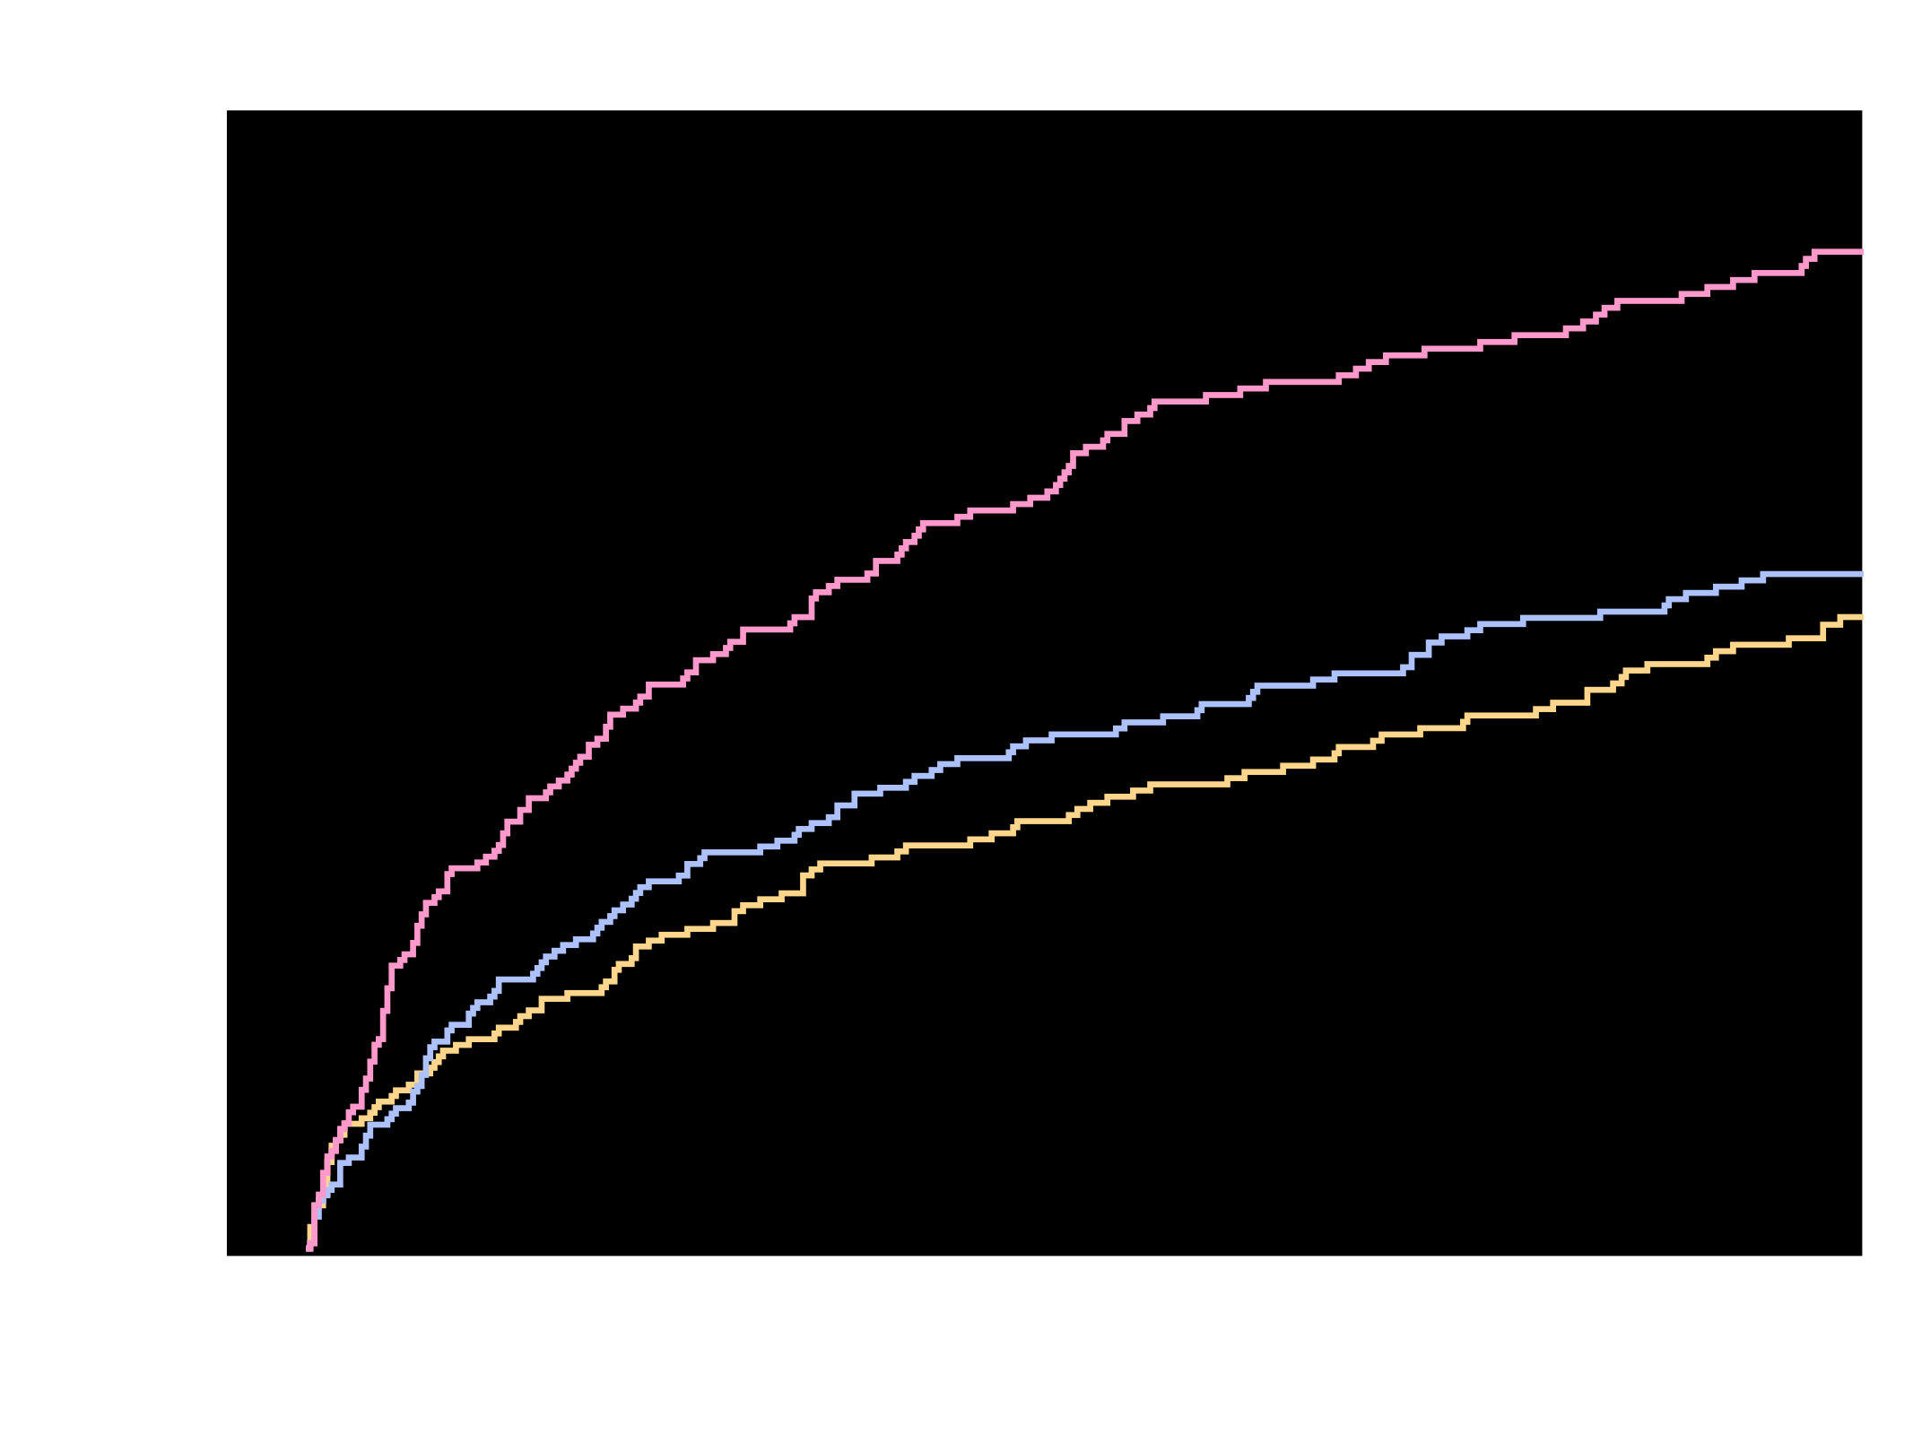
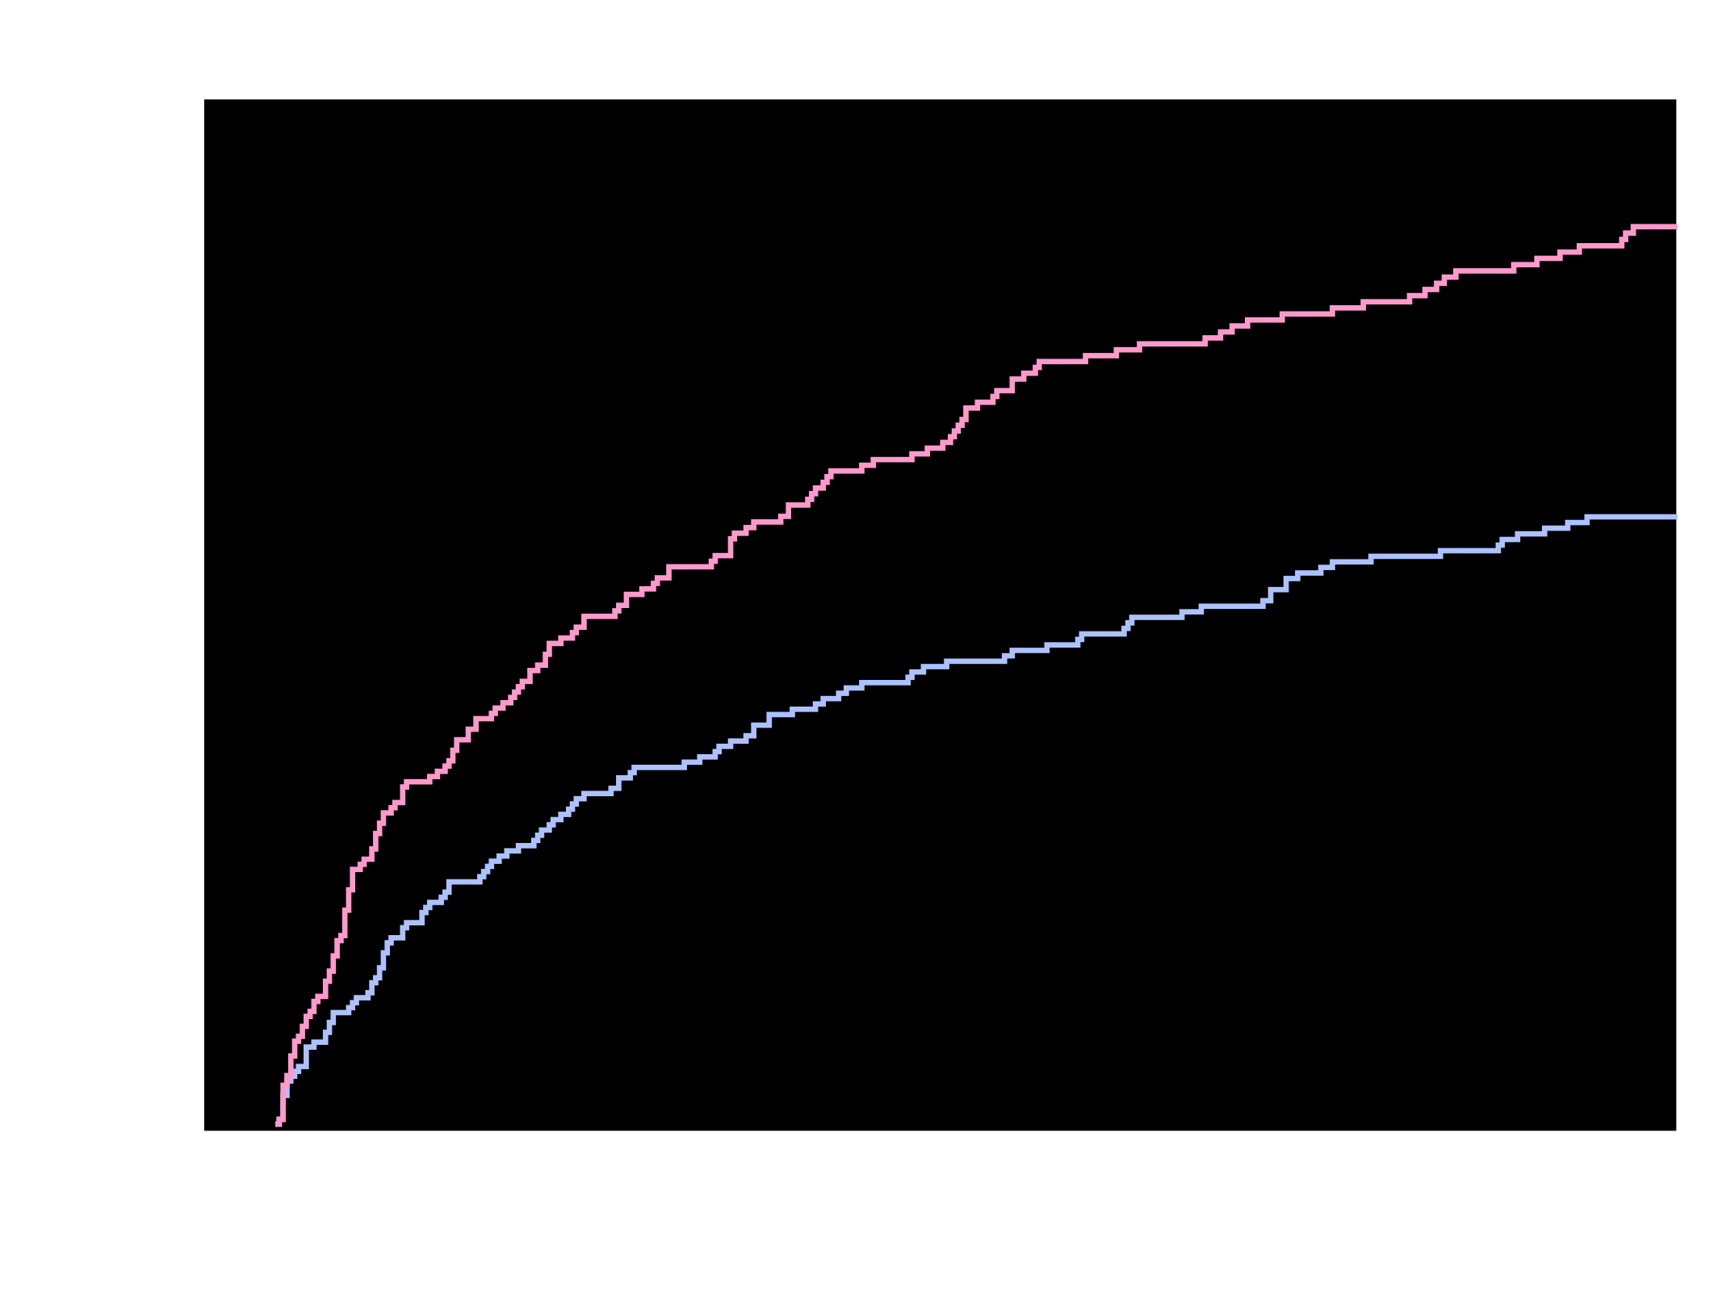
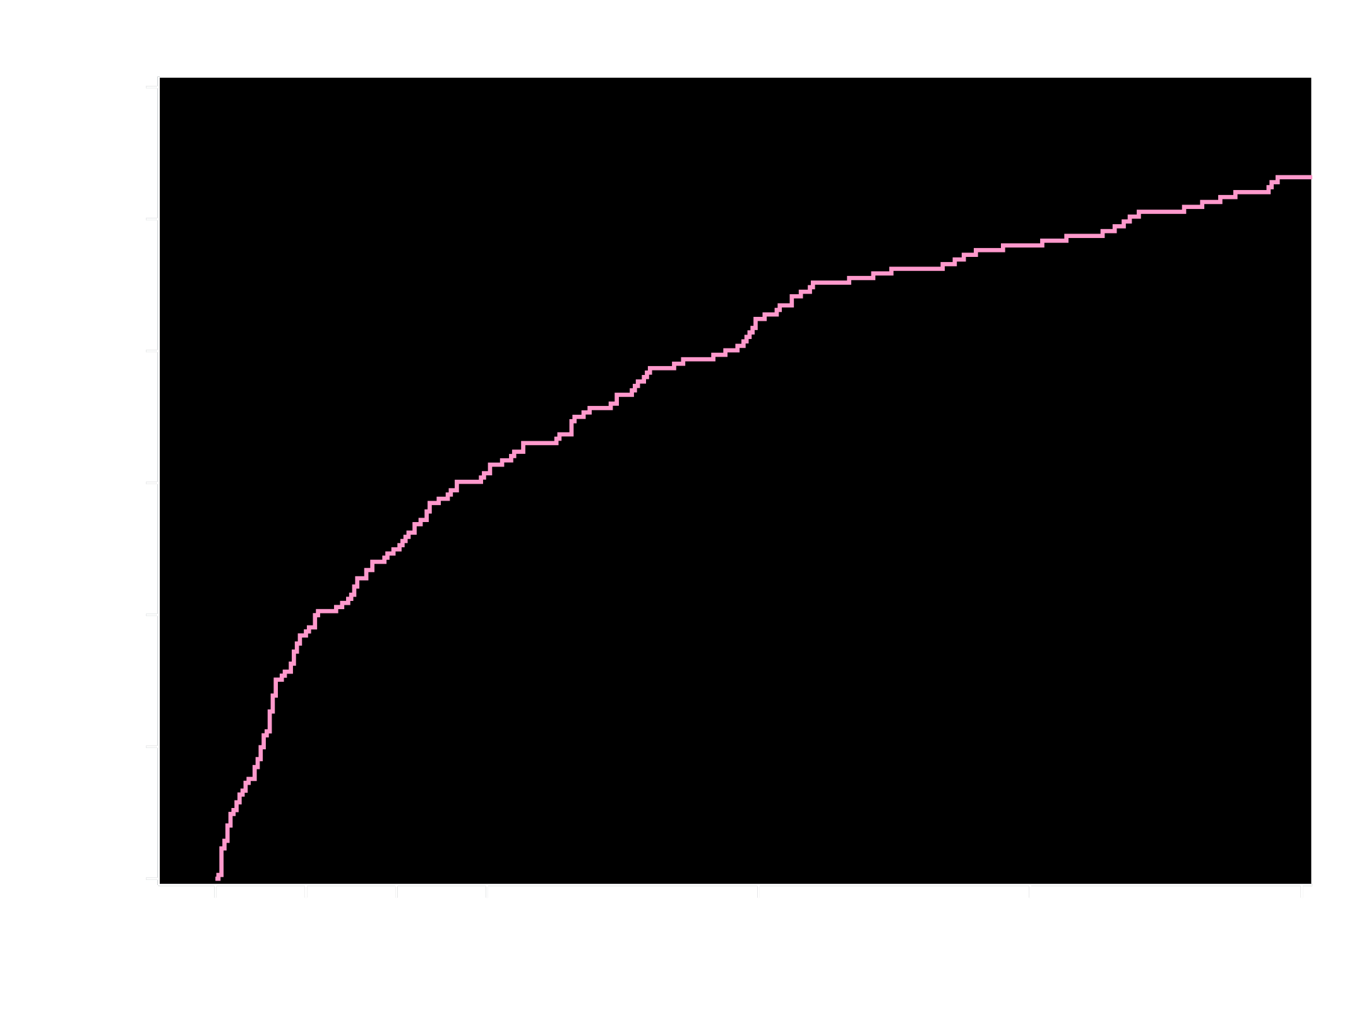
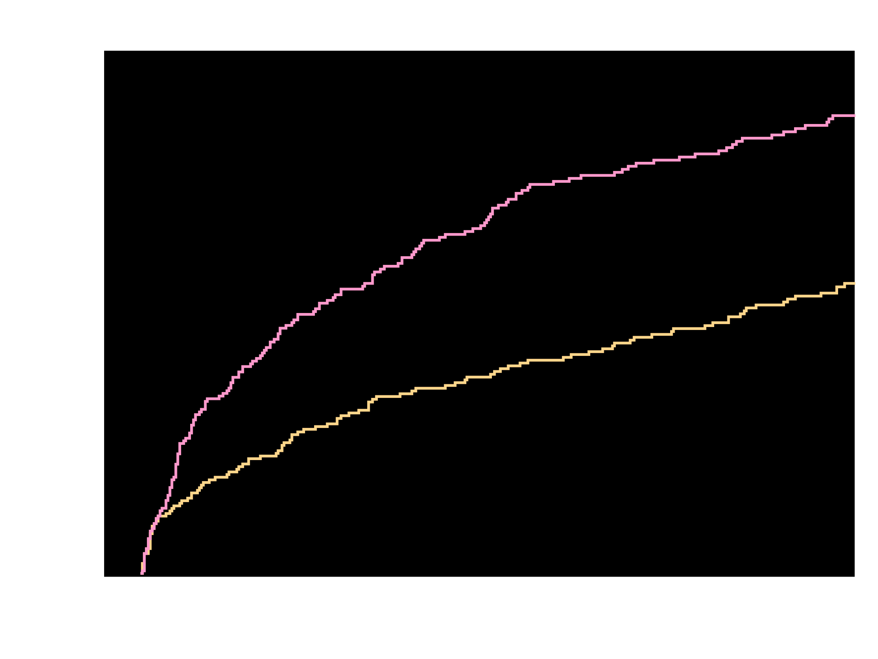
Kaplan-Meier Estimates of First Occurrence
of Clinically Significant Bleeding Events
TIMI Major, TIMI Minor, or Bleeding Requiring Medical Attention (%)
26.7%
p<0.00018
p<0.000013
18.0%
VKA + DAPT
16.8%
VKA + DAPT
VKA + DAPT
VKA + DAPT
Riva + DAPT
Riva + DAPT
Riva + P2Y₁₂
Riva + P2Y₁₂
HR = 0.63 (95% CI 0.50-0.80)
ARR = 8.7
NNT = 12
HR = 0.59 (95% CI 0.47-0.76)
ARR = 9.9
NNT = 11
Riva + P2Y₁₂ v. VKA + DAPT
HR=0.59 (95% CI: 0.47-0.76)
p <0.000013
ARR=9.9
NNT=11
Riva + DAPT v. VKA + DAPT
HR=0.63 (95% CI: 0.50-0.80)
p <0.00018
ARR=8.7
NNT=12
Days
No. at risk
VKA + DAPT
Riva + DAPT
VKA + DAPT
Riva + P2Y₁₂
VKA + DAPT
Riva + P2Y₁₂
Riva + DAPT
VKA + DAPT
697
706
697
696
697
696
706
697
593
636
593
628
593
628
636
593
329
409
329
383
409
329
555
383
329
600
555
606
555
606
600
555
521
579
521
585
521
585
579
521
461
543
461
543
461
543
543
461
426
509
426
510
426
510
509
426
Treatment-emergent period: period starting after the first study drug administration following randomization and ending 2 days after stop of study drug. Clinically significant bleeding is the composite of TIMI major, TIMI minor, and BRMA. Hazard ratios as compared to the VKA group are based on the (stratified, only for Overall, 2.5 mg BID/15 mg QD comparing VKA) Cox proportional hazards model. Log-Rank P-values as compared to VKA group are based on the (stratified, only for Overall, 2.5 mg BID/15 mg QD comparing VKA) two-sided log rank test.
Gibson et al. AHA 2016

Slide 28
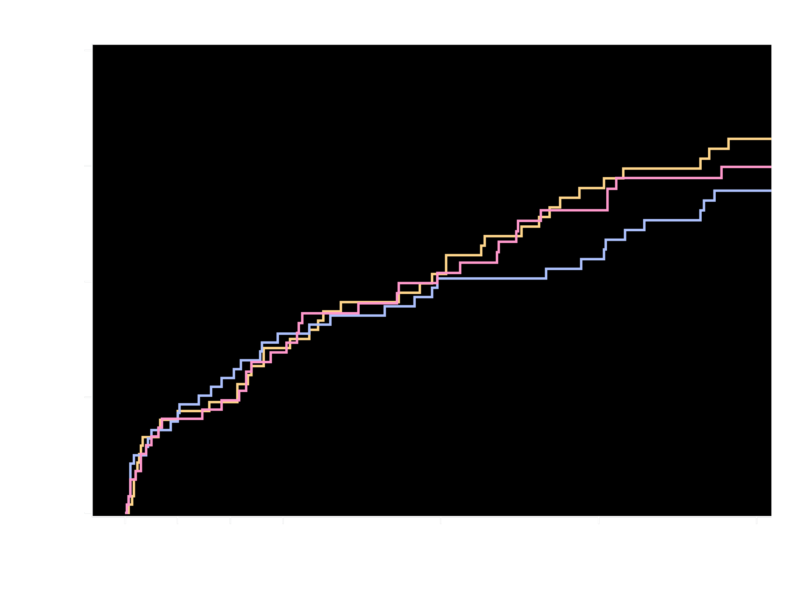
Kaplan-Meier Estimates of First
Occurrence of CV Death, MI or Stroke
Cardiovascular Death, Myocardial Infarction, or Stroke (%)
6.5%
Riva + P2Y₁₂
6.0%
5.6%
Riva + DAPT
VKA + DAPT
Riva + P2Y₁₂ v. VKA + DAPT
HR=1.08 (95% CI: 0.69-1.68)
p=0.750
Riva + DAPT v. VKA + DAPT
HR=0.93 (95% CI: 0.59-1.48)
p=0.765
No. at risk
Days
Riva + P2Y₁₂
Riva + DAPT
VKA + DAPT
694
704
695
648
662
635
633
640
607
621
628
579
590
596
543
562
570
514
430
457
408
Treatment-emergent period: period starting after the first study drug administration following randomization and ending 2 days after stop of study drug.
Composite of adverse CV events is composite of CV death, MI, and stroke. Hazard ratios as compared to VKA group are based on the (stratified, only for the Overall, 2.5 mg BID/15 mg QD comparing VKA) Cox proportional hazards model. Log-Rank P-values as compared to the VKA group are based on the (stratified, only for Overall, 2.5 mg BID/115 mg QD comparing VKA) two-sided log rank test.
6 Subjects were excluded from all efficacy analyses because of violations in Good Clinical Practice guidelines
Gibson et al. AHA 2016

Slide 29
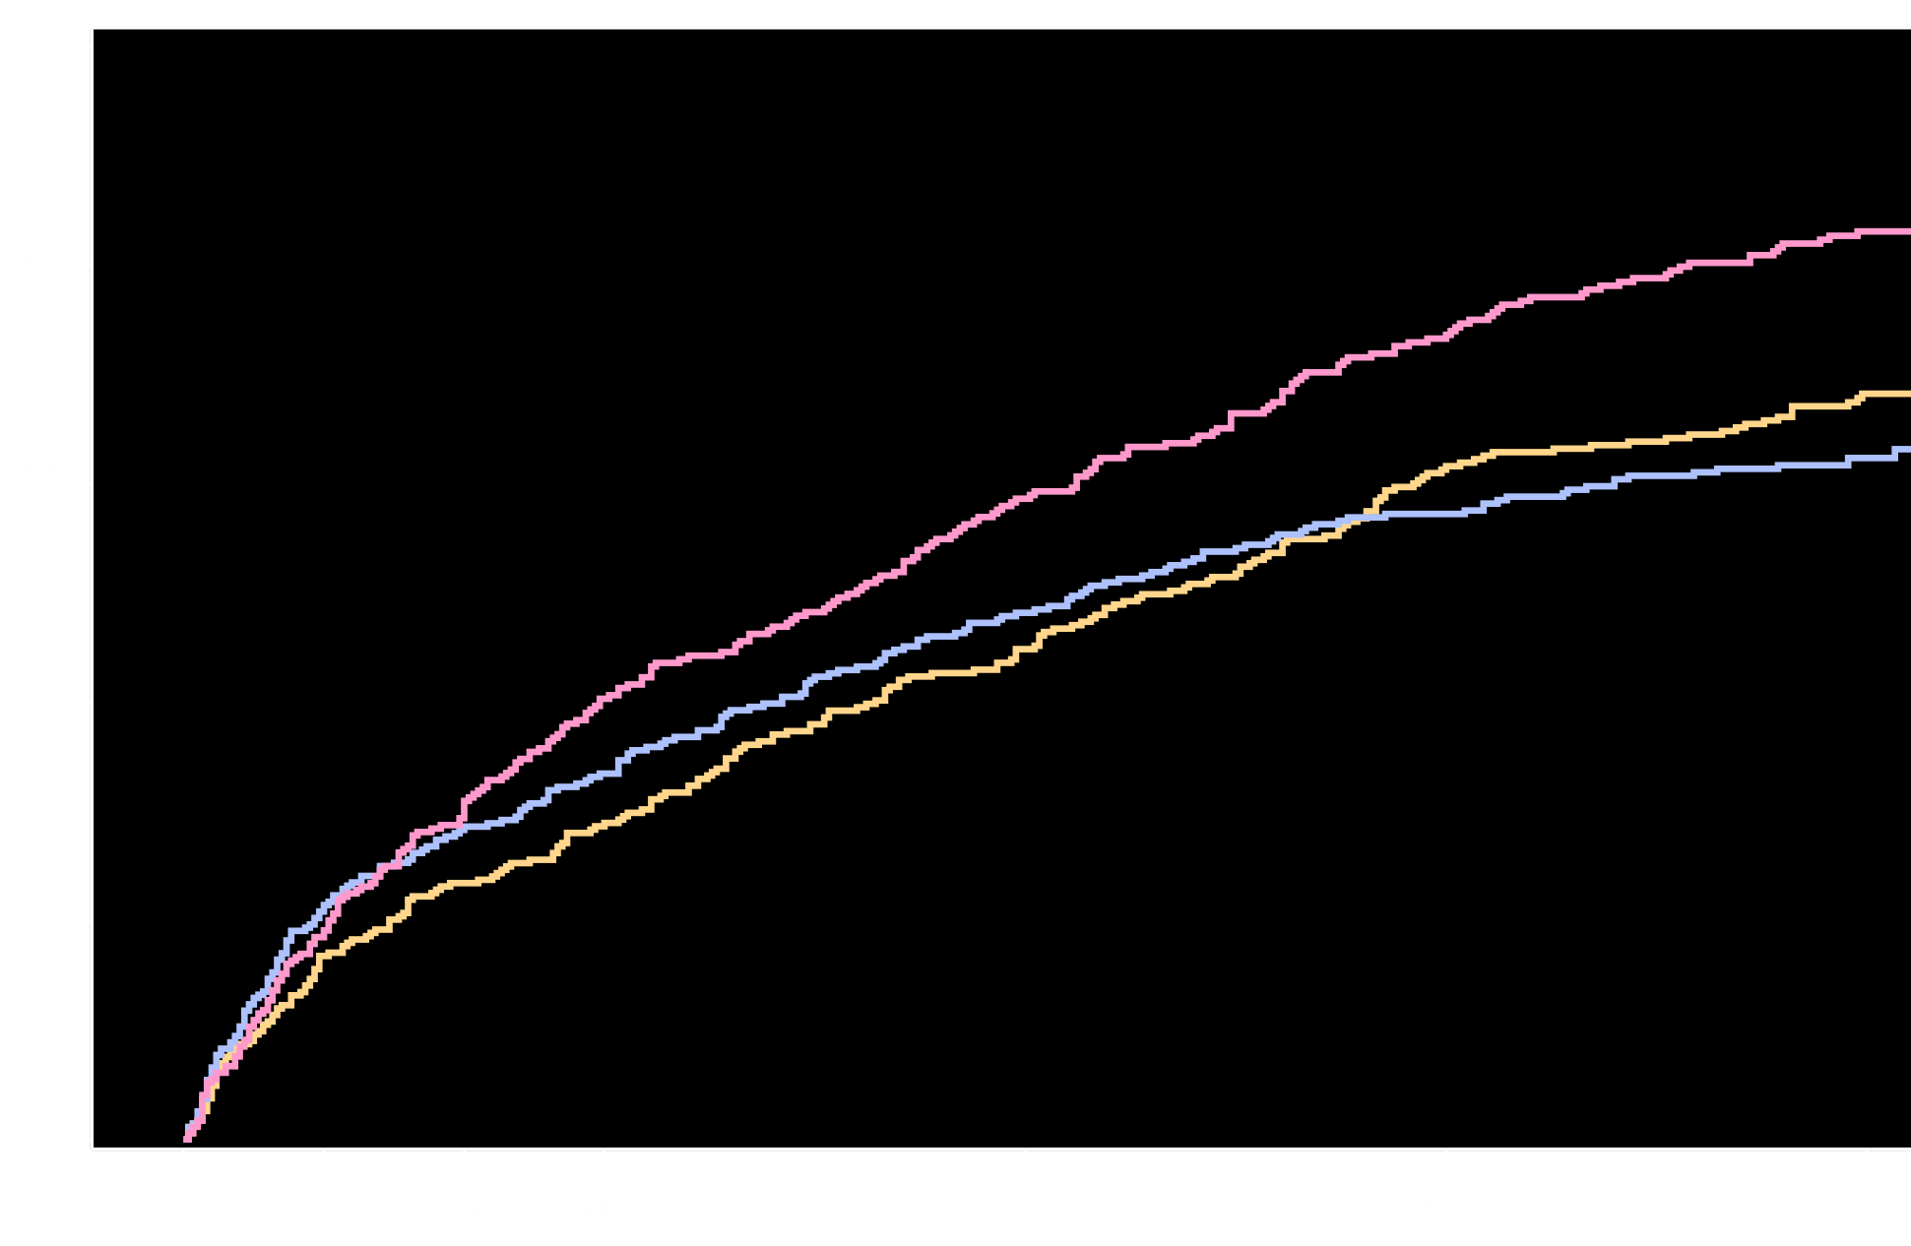
All Cause Hospitalization for an Adverse Event
All Cause Rehospitalization (%)
41.5%
VKA + DAPT
Riva + P2Y₁₂
34.1%
31.2%
Riva + DAPT
Riva + P2Y₁₂ v. VKA + DAPT
HR=0.77 (95% CI: 0.65-0.92)
p=0.005
ARR=7.4
NNT=14
Riva + DAPT v. VKA + DAPT
HR=0.74 (95% CI: 0.61-0.88)
p=0.001
ARR=10.3
NNT=10
No. at risk
Days
Riva + P2Y₁₂
Riva + DAPT
VKA + DAPT
696
706
697
609
607
592
582
570
540
559
548
490
496
493
422
437
454
369
322
367
272
Treatment-emergent period: period starting after the first study drug administration following randomization and ending 2 days after stop of study drug. Rehospitalizations do not include the index event and include the first rehospitalization after the index event. Hazard ratios as compared to the VKA group are based on the Cox proportional hazards model. Log-Rank P-values as compared to VKA group are based on the two-sided log rank test.
Gibson et al. AHA 2016

Slide 30
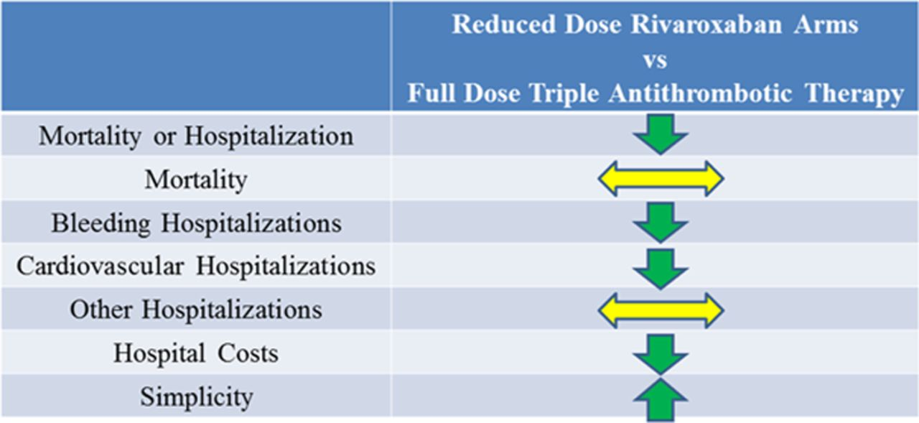
Bhatt DL, Circulation. 2016;134:00–00. DOI: 10.1161/CIRCULATIONAHA.116.025923
Gibson et al. AHA 2016

Slide 31
Primary Endpoint: Time to first ISTH major or clinically relevant non-major bleeding event
40
40
HR: 0.52 (95% CI: 0.42–0.63)
Non-inferiority P<0.0001
P<0.0001
Warfarin
triple therapy
HR: 0.72 (95% CI: 0.58–0.88)
Non-inferiority P<0.0001
P=0.002
35
35
Warfarin
triple therapy
30
30
25
25
20
20
Dabigatran 150 mg
dual therapy
Probability of event (%)
15
Dabigatran 110 mg
dual therapy
15
10
10
5
5
0
0
0
90
180
270
360
450
540
630
720
0
90
180
270
360
450
540
630
720
Time to first event (days)
Time to first event (days)
Full analysis set presented. HRs and Wald CIs from Cox proportional-hazard model. For the dabigatran 110 mg vs warfarin comparison, the model is stratified by age, non-elderly vs elderly (<70 or ≥70 in Japan and <80 or ≥80 years old elsewhere). For the dabigatran 150 mg vs warfarin comparison, an unstratified model is used, elderly patients outside the USA are excluded. Non-inferiority P value is one sided (alpha=0.025). Wald two-sided P value from (stratified) Cox proportional-hazard model (alpha=0.05)

Slide 32
Additional individual thromboembolic endpoints
 | Dabigatran 110 mg dual therapy (n=981) n (%) | Warfarin triple therapy (n=981) n (%) | D110 DT vs warfarin TT |  | Dabigatran 150 mg dual therapy (n=763) n (%) | Warfarin triple therapy (n=764) n (%) | D150 DT vs warfarin TT
 |  |  | HR (95% CI) | P value
 |  |  |  |  |  |  | HR (95% CI) | P value
DTE or unplanned revascularisation | 149 (15.2) | 131 (13.4) | 1.13 (0.90–1.43) | 0.30 | 90 (11.8) | 98 (12.8) | 0.89 (0.60–1.19) | 0.44
All-cause death | 55 (5.6) | 48 (4.9) | 1.12 (0.76–1.65) | 0.56 | 30 (3.9) | 35 (4.6) | 0.83 (0.51–1.34) | 0.44
Stroke | 17 (1.7) | 13 (1.3) | 1.30 (0.63–2.67) | 0.48 | 9 (1.2) | 8 (1.0) | 1.09 (0.42–2.83) | 0.85
Unplanned revascularization | 76 (7.7) | 69 (7.0) | 1.09 (0.79–1.51) | 0.61 | 51 (6.7) | 52 (6.8) | 0.96 (0.65–1.41) | 0.83
MI | 44 (4.5) | 29 (3.0) | 1.51 (0.94–2.41) | 0.09 | 26 (3.4) | 22 (2.9) | 1.16 (0.66–2.04) | 0.61
Stent thrombosis | 15 (1.5) | 8 (0.8) | 1.86 (0.79–4.40) | 0.15 | 7 (0.9) | 7 (0.9) | 0.99 (0.35–2.81) | 0.98
Results presented are times to event. Stent thrombosis is time to definite stent thrombosis. Cannon C, et al. N Engl J Med 2017. [Epub ahead of print]

Slide 33
Angiolillo DJ et al. Circulation 2018; 138:527–536.

Slide 34
Peri- and post-procedural Considerations
Angiolillo DJ et al. Circ Cardiovasc Interv. 2016

Slide 35
Aspirin might be no longer needed after 12 months in AF patients with stable CAD on VKA
Age ad gender adj. HR (95% CI)
No difference
In CV death/MI/CVA in
patients treated with VKA + APT versus patients treated with VKA alone
adj. HR: 1.15
95% CI 0.58-2.27 p=0.697
SAT
Reference
DAPT
1.58 [0.72-3.47]
VKA+SAT
7.30 [3.91-13.64]
VKA alone
1.69 [0.39-7.30]
0.1
1
100
CORONOR – 4,184 patients on oral anticoagulation with stable (>12 mo) CAD
Hamon M, et al. J Am Coll Cardiol 2014;64:1430–6

Slide 36
Bleeding risk in PCI patients on DAPT + VKA
%
100
95.1 %
90
95.1 %
80
Bleeding event free survival
70
†
Dual therapy
‡
66.7 %
60
Triple therapy (INR: 2.0-2.5)
Triple therapy (INR > 2.5)
50
0
200
300
450
600
† Log Rank, p<0.0001 vs dual therapy
Days
‡ Log Rank, p<0.0001 vs triple therapy (INR: 2.0-2.5)
Rossini & Angiolillo, Am J Cardiol. 2008;102:1618-23

Slide 37
North American Expert Consensus on the Management of Antithrombotic Therapy in Patients with AF Undergoing PCI – Summary of the 2018 Focused Update
In AF patients requiring OAC treated with stents a double-therapy regimen (OAC plus P2Y₁₂ inhibitor) after hospital discharge should be considered the default strategy for most patients. However, it is reasonable to extend low-dose aspirin therapy (i.e., triple-therapy) for a limited period of time (e.g., one-month) post-PCI in selected patients at high ischemic/thrombotic and low bleeding risks.
A NOAC should be preferred over a VKA. The dosing regimen of a NOAC should be that recommended for thromboembolic protection in AF patients, while the use of lower doses is not recommended, unless specifically studied in randomized trials (i.e., rivaroxaban 15 mg or 10mg if CKD). Where different therapeutic dosing options (i.e., dabigatran 110 and 150 mg) are available, the intensity of anticoagulant treatment should be tailored according to the bleeding and thrombotic risk profile of the patient. After discontinuation of SAPT, OAC should be resumed at full stroke prevention doses (e.g., rivaroxaban 20 mg or 15 mg if CKD)
In patients already on a VKA, continuing with the same agent after PCI may be reasonable, particularly if the patient has been compliant, with well-controlled INR, and has not experienced complications, targeting an INR in the lower therapeutic range. A VKA remains the only indicated treatment for patients with moderate to severe mitral stenosis or who have a mechanical prosthetic heart valve and is generally preferred in patients with severe renal dysfunction.
The intensity and duration of antiplatelet treatment should also be tailored according to the bleeding and thrombotic risk profile of the patient. Clopidogrel remains the P2Y₁₂ inhibitor of choice, but ticagrelor may be considered in selected patients, particularly those at high ischemic/thrombotic risk and low bleeding risk.
Discontinuation of SAPT at one-year should be considered for most patients who should continue treatment on stroke prevention doses of OAC. However, in patients at low ischemic/thrombotic risk as well as those at high risk for bleeding it is reasonable to discontinue SAPT at 6 months post-PCI, while continuation with SAPT (in addition to OAC) may be reasonable for select patients with high ischemic/thrombotic and low bleeding risks.
Angiolillo DJ et al. Circulation 2018; 138:527–536.

