Slide 1
PREPARE-CALC: A Randomized Trial of High-speed Rotational Atherectomy Prior to Drug-Eluting Stent Implantation in Severely Calcified Coronary Lesions
Gert Richardt, MD
Heart Center Segeberger Kliniken, Bad Segeberg Germany
for the PREPARE-CALC investigators
Clinicaltrials.gov: NCT02502851

Slide 2
Disclosure Statement of Financial Interest
I, Gert Richardt have received speaker’s honoraria from Boston Scientific and Biotronik.

Slide 3
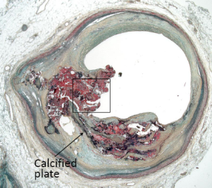
Patients with Severely Calcified Lesions
Elderly with numerous comorbidities
Growing demand for revascularisation
Increased periprocedural complications
More long-term adverse events
Mostly excluded from randomized PCI trials
Poor evidence for best PCI practice
Madhavan et al. J Am Coll Cardiol 2014;63:1703 - Généreux et al. J Am Coll Cardiol 2014;63:1845

Slide 4
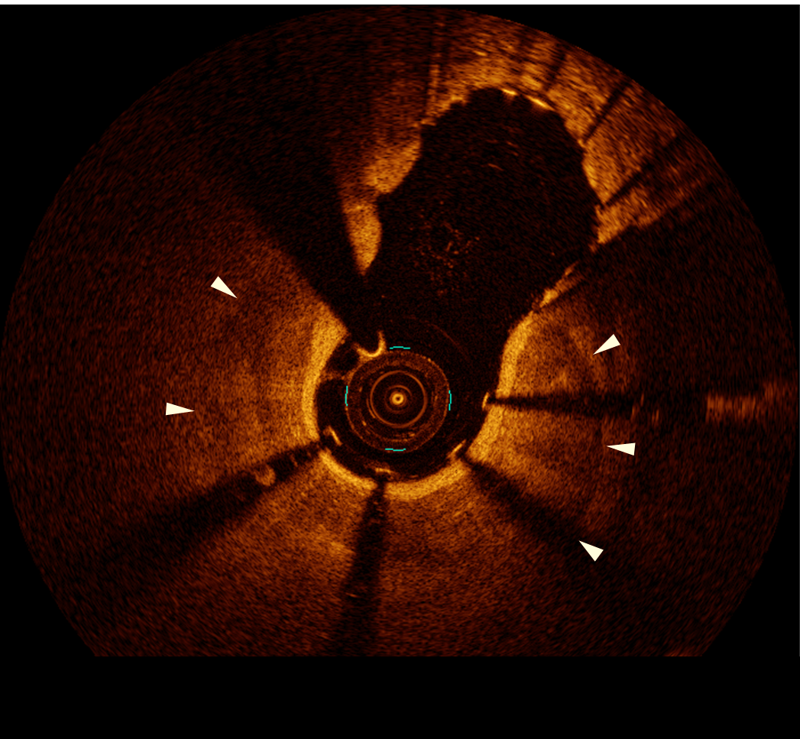
Lesion Preparation in Severe Calcification
Essential to facilitate stent delivery and adequate stent expansion ⁽¹⁾
Compared to standard balloons, rotational atherectomy ⁽²⁾
Increases acute success of the procedure
Achieves more acute luminal gain
Stimulates neointima formation and causes more late lumen loss
Availability of modified balloons (scoring/cutting) and new generation DES may impact PCI practice
Stent damage
Stent underexpansion
(1) Barbato et al. EuroIntervention 2017;13:696 - (2) Abdel-Wahab et al. JACC Cardiovasc Interv 2013;6:10
Notes:
3
This is the Bulleted List slide.
To create this particular slide, click the NEW SLIDE button on your toolbar and choose the BULLETED LIST format. (Top row, second from left)
The Sub-Heading and footnote will not appear when you insert a new slide. If you need either one, copy and paste it from the sample slide.
If you choose not to use a Sub-Heading, let us know when you hand in your presentation for clean-up and we’ll adjust where the bullets begin on your master page.
Also, be sure to insert the presentation title onto the BULLETED LIST MASTER as follows:
Choose View / Master / Slide Master from your menu.
Select the text at the bottom of the slide and type in a short version of your presentation title.
Click the SLIDE VIEW button in the lower left hand part of your screen to return to the slide show. (Small white rectangle)

Slide 5
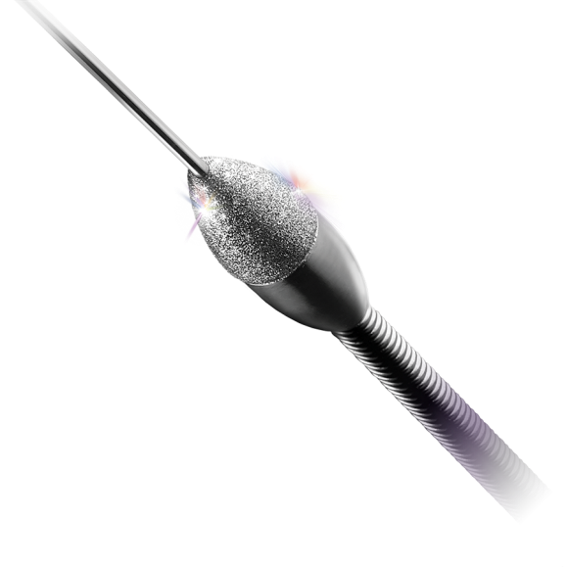
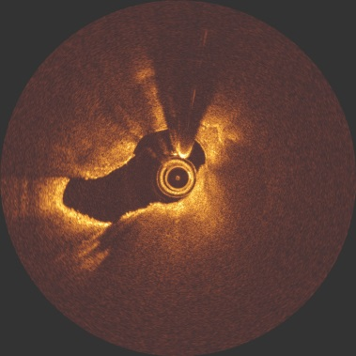
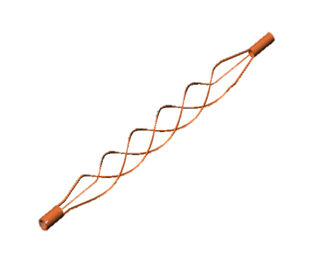
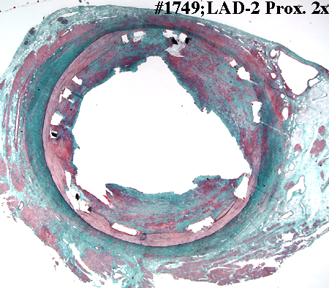
Established Techniques for Lesion Preparation
High-speed rotational atherectomy
Plaque modification by differential cutting
Scoring/cutting balloon
Focal concentration of dilatation force
with controlled incisions of the lesion
Notes:
4
This is the Bulleted List slide.
To create this particular slide, click the NEW SLIDE button on your toolbar and choose the BULLETED LIST format. (Top row, second from left)
The Sub-Heading and footnote will not appear when you insert a new slide. If you need either one, copy and paste it from the sample slide.
If you choose not to use a Sub-Heading, let us know when you hand in your presentation for clean-up and we’ll adjust where the bullets begin on your master page.
Also, be sure to insert the presentation title onto the BULLETED LIST MASTER as follows:
Choose View / Master / Slide Master from your menu.
Select the text at the bottom of the slide and type in a short version of your presentation title.
Click the SLIDE VIEW button in the lower left hand part of your screen to return to the slide show. (Small white rectangle)

Slide 6
Objective
… to compare rotational atherectomy with modified balloons (scoring/cutting) in severely calcified lesions regarding acute success and intermediate-term efficacy.

Slide 7
Study Design
Prospective, randomized, active-controlled clinical trial in two German centers
SES implantation (Orsiro)
9-month angiographic & clinical follow-up
1 & 2-years clinical follow-up
PCI in 200 patients with severely calcified lesions
* Predilatation with standard balloons was allowed to facilitate delivery of modified balloons
Lesion preparation with
modified balloon*
(scoring/cutting)
randomization
Lesion preparation with
rotational atherectomy
1:1

Slide 8
Key In- & Exclusion Criteria
INCLUSION
EXCLUSION
Anginal symptoms and/or evidence of ischemia
De-novo lesion in native coronary artery
Ref. vessel diameter 2.25-4.0 mm
Luminal diam. reduction of 50-100%
Severe calcification of the target lesion *
Myocardial infarction within one week
Decompensated heart failure
Target lesion in a coronary bypass
Target lesion is an in-stent restenosis
Thrombus in the target vessel
* Mintz et al. Circulation 1995;91:1959-65

Slide 9
Primary Endpoints
Strategy success
(successful stent delivery and expansion with < 20% in-stent residual stenosis and TIMI 3 flow without crossover or stent failure; powered for superiority)
In-stent late-lumen-loss at 9 months
(powered for non-inferiority)

Slide 10
Secondary Endpoints
Procedural duration
Contrast dye amount
Peri-procedural myocardial infarction
In-segment LLL
Binary restenosis (in-stent and in-segment)
Stent thrombosis
Target vessel failure (TVF) at 9 months

Slide 11
Determination of Study Size
Assumptions:
Strategy success: RA 90% vs MB 75%*
100 patients in each arm to detect superiority
LLL: 0.2 mm in both groups
74 patients in each arm with 1.3 lesions/patient
to detect non-inferiority (non-inferiority margin 0.2mm)
For both 80% power at an alpha level of 0.05
* Abdel-Wahab et al. JACC Cardiovasc Interv 2013;6:10

Slide 12
Study Organization
Steering Committee: Mohamed Abdel-Wahab, Ralph Toelg, Gert Richardt
Participating Centers
Heart Center, Segeberger Kliniken, Bad Segeberg, Germany
German Heart Center, Technical University of Munich, Munich, Germany
Study devices
Flextome cutting balloon (Boston Scientific)
AngioSculpt scoring balloon (Biotronik)
Scoreflex scoring balloon (OrbusNeich Medical)
Rotablator (Boston Scientific)
Sirolimus-eluting Orsiro stent (Biotronik)
Independent Clinical Event Committee (Chair: M. Ferenc, Bad Krozingen, Germany)
Independent QCA Core Lab (ISAR Research Center, Munich, Germany)
Independent Statistical Core Lab (Derek Robinson, Sussex, UK)

Slide 13
Enrollment and Follow-Up
September 2014 to October 2017

Slide 14
Baseline Characteristics
 | Modified balloon (n = 100 pts.) | Rotational atherectomy (n = 100 pts.) | p-value
Age (years) | 75.0 ± 6.9 | 74.8 ± 7.1 | 0.79
Males | 75 (75%) | 77 (77%) | 0.74
Diabetes mellitus | 34 (34%) | 33 (33%) | 0.88
Hypertension | 93 (93%) | 93 (93%) | 1.00
Dyslipidemia | 69 (69%) | 68 (68%) | 0.88
Current smokers | 9 (9%) | 15 (15%) | 0.19
Chronic renal failure* | 21 (21%) | 26 (26%) | 0.40
Previous MI | 22 (22%) | 21 (21%) | 0.86
Previous CABG | 13 (13%) | 6 (6%) | 0.09
Unstable angina | 9 (9%) | 8 (8%) | 0.80
Left main disease | 37 (37%) | 23 (23%) | 0.03
Multivessel disease | 70 (70%) | 74 (74%) | 0.52
LV ejection fraction (%) | 56.9 ± 10.6 | 55.7 ± 11.7 | 0.45
* defined as glomerular filtration rate < 60 ml/min

Slide 15
Angiographic & Procedural Characteristics
 | Modified balloon (n = 137 lesions) | Rotational atherectomy (n = 141 lesions) | p-value
Location |  |  | 0.30
Left main | 20 (14.6%) | 15 (10.6%)
Left anterior descending | 61 (44.5%) | 78 (55.3%)
Left circumflex | 16 (11.7%) | 16 (11.3%)
Right coronary artery | 40 (29.2%) | 32 (22.7%)
Reference vessel diameter (mm) | 3.31±0.44 | 3.25±0.47 | 0.25
Diameter stenosis (%) | 83.54±8.76 | 83.02±10.35 | 0.80
Ostial location | 35 (25.5%) | 40 (28.4%) | 0.52
Bifurcation | 61 (44.5%) | 55 (39.0%) | 0.37
Chronic total occlusion | 4 (2.9%) | 4 (2.8%) | 1.00
B2/C lesion | 129 (94.2%) | 137 (97.2%) | 0.62
7 Fr guiding catheter | 111 (81.0%) | 130 (92.2%) | 0.002
Cutting/scoring balloon diameter (mm) | 2.94±0.34 | -- | --
Max. burr size (mm) | -- | 1.53±0.18 | --
Balloon predilatation | 103 (75.2%) | 119 (84.4%) | 0.04
Total stent length / lesion (mm) | 35.41±18.00 | 35.63±15.69 | 0.94
Max. stent implantation pressure (atm) | 17.47±3.54 | 16.47±2.87 | 0.02
Balloon postdilatation | 117 (83.0%) | 111 (81.0%) | 0.70
Max. postdil. balloon diameter (mm) | 3.70±0.54 | 3.68±0.49 | 0.76
Max. postdil. balloon pressure (atm) | 21.86±4.65 | 20.95±4.88 | 0.12

Slide 16
Procedural and In-Hospital Outcome
 | Modified balloon (n = 100 pts.) | Rotational atherectomy (n = 100 pts.) | p-value
Procedural duration (min) | 78.5±40.6 | 88.2±34.9 | 0.07
Fluoroscopy time (min) | 19.6±13.4 | 23.9±12.2 | 0.03
Contrast amount (ml) | 230.0±93.8 | 233.0±109.1 | 0.83
Large dissection (> 5mm) | 7 (7%) | 3 (3%) | 0.33
Side branch compromise | 13(13%) | 6 (6%) | 0.09
Perforation | 2 (2%) | 4 (4%) | 0.68
Pericardial effusion | 0 (0%) | 3 (3%) | 0.24
Death | 0 (0%) | 0 (0%) | 1.00
Myocardial infarction | 1 (1%) | 2 (2%) | 1.00
TVR | 0 (0%) | 0 (0%) | 1.00
Stent thrombosis | 0 (0%) | 0 (0%) | 1.00
Access site complications | 5 (5%) | 3 (3%) | 0.72

Slide 17
Primary Endpoint – Strategy Success
 | Modified balloon (n = 100 pts.) | Rotational atherectomy (n = 100 pts.) | p-value
Strategy success | 81 (81%) | 98 (98%) | 0.0001
Final TIMI flow < III | 0 (0%) | 1 (1%) | 0.99
Residual stenosis >20% | 2 (2%) | 0 (0%) | 0.49
Stent failure | 4 (4%) | 1 (1%) | 0.36
Crossover | 16 (16%) | 0 (0%) | <0.0001

Slide 18
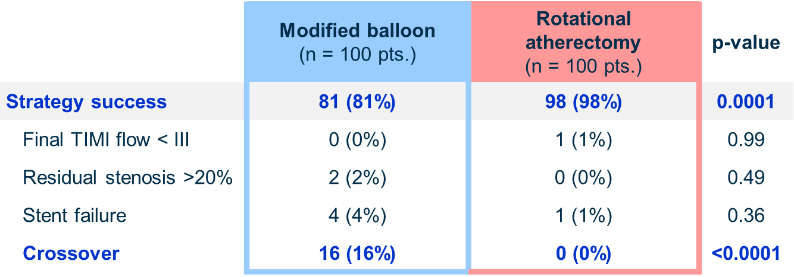
Cross-Over Patients

Slide 19
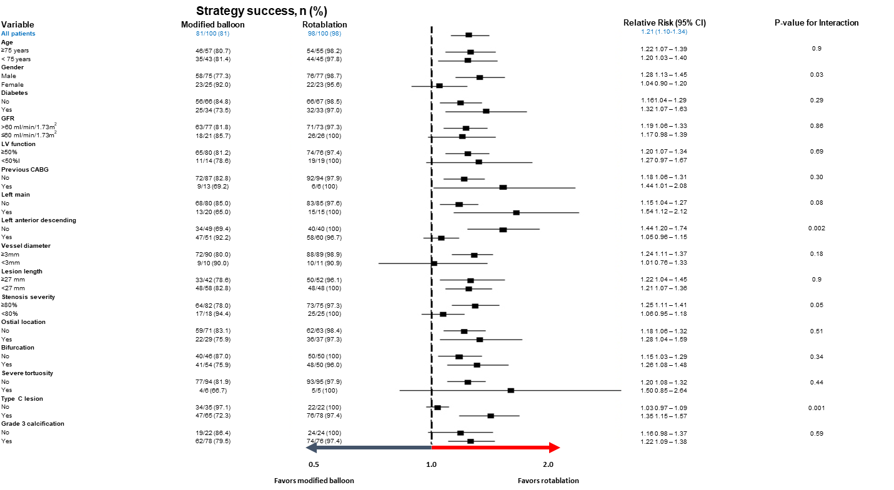
Subgroup Analysis

Slide 20
Subgroup Analysis
No
Advantage of RA
Female gender
LAD as target
Non Type C lesion

Slide 21
Baseline QCA
 | Modified balloon (n = 136 lesions) | Rotational atherectomy (n = 137 lesions) | p-value
Before the procedure
Lesion length (mm) | 20.16±11.88 | 20.86±12.30 | 0.63
Reference vessel diameter (mm) | 3.08±0.47 | 3.10±0.49 | 0.84
Minimal lumen diameter (mm) | 1.07±0.34 | 1.15±0.35 | 0.07
Diameter stenosis (%) | 65.18±9.53 | 63.43±9.80 | 0.16
Immediately after the procedure
Minimal lumen diameter (mm)
In-stent | 2.81±0.47 | 2.85±0.43 | 0.56
In-segment | 2.58±0.53 | 2.62±0.67 | 0.61
Diameter stenosis (%)
In-stent | 12.34±5.14 | 12.62±5.36 | 0.63
In-segment | 17.12±7.39 | 17.58±7.31 | 0.59
Acute gain (mm)
In-stent | 1.74±0.45 | 1.70±0.42 | 0.45
In-segment | 1.50±0.51 | 1.47±0.64 | 0.61

Slide 22
Co-Primary Endpoint – In stent LLL at 9 Month

Slide 23
QCA at 9 Month
 | Modified balloon (n = 112 lesions) | Rotational atherectomy (n = 97 lesions) | p-value
Minimal lumen diameter (mm)
In-stent | 2.68±0.59 | 2.64±0.51 | 0.59
In-segment | 2.50±0.54 | 2.50±0.55 | 0.96
Diameter stenosis (%)
In-stent | 18.83±13.42 | 19.75±11.54 | 0.49
In-segment | 22.40±11.36 | 23.30±11.43 | 0.52
Late lumen loss (mm)
In-stent | 0.16±0.40 | 0.22±0.41 | 0.21
In-segment | 0.07±0.52 | 0.18±0.74 | 0.25
Binary restenosis (%)
In-stent | 6 (5.3%) | 2 (2.1%) | 0.30
In-segment | 5 (4.5%) | 2 (2.1%) | 0.32

Slide 24
Clinical Outcome at 9 Month
 | Modified balloon (n = 100 pts.) | Rotational atherectomy (n = 100 pts.) | p-value
Death | 2 (2%) | 2 (2%) | 1.00
Cardiac death | 1 (1%) | 1 (1%) | 1.00
Non-cardiac death | 1 (1%) | 1 (1%) | 1.00
Myocardial infarction | 3 (3%) | 2 (2%) | 1.00
Target vessel MI | 1 (1%) | 2 (2%) | 1.00
Periprocedural MI | 1 (1%) | 2 (2%) | 1.00
Spontaneous MI | 2 (2%) | 0 (0%) | 0.50
Stent thrombosis (def./prob.) | 0 (0%) | 0 (0%) | 1.00
TVR | 8 (8%) | 3 (3%) | 0.21
Target vessel failure | 8 (8%) | 6 (6%) | 0.78

Slide 25
Limitations
Cross-over is a potential source of bias
Not powered for clinical endpoints
Mainly transfemoral approach
Exclusion of acute and clinically unstable patients
Angiography-guided procedures
Other techniques not tested (Orbital atherectomy, Laser, Lithoplasty etc.)

Slide 26
Summary
In patients with severely calcified coronary lesions
Elective RA is feasible in nearly all patients and the acute success rate is superior to modified balloons.
Both approaches (elective RA and balloon plus bailout RA) are equally safe and effective.
Use of RA is no longer associated with excessive LLL in the era of modern SES.

Slide 27
M. Abdel-Wahab, G. Richardt and coauthors
High-Speed Rotational Atherectomy Versus Modified Balloons Before Drug-Eluting Stent Implantation in Severely Calcified Coronary Lesions: The Randomized PREPARE-CALC Trial
Published online September 24, 2018

Slide 28
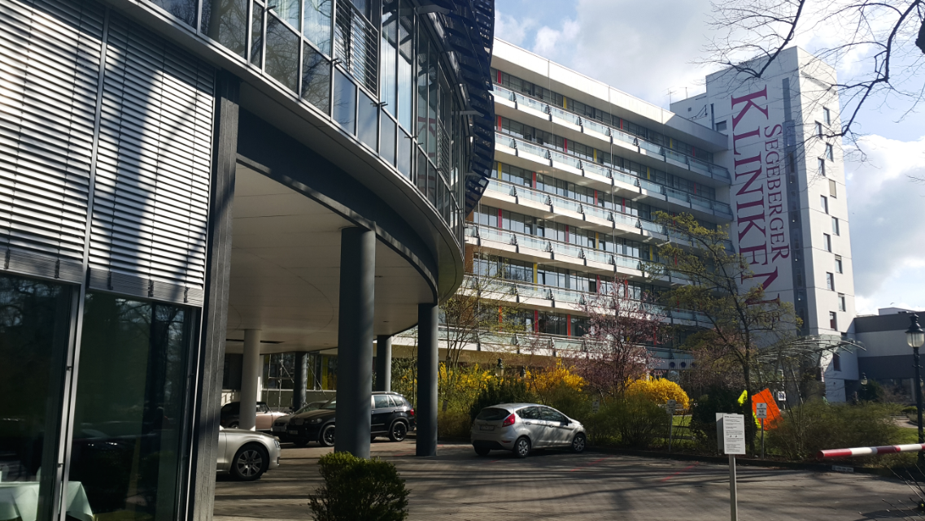
Thank you !

