Slide 1



A Three-Arm Randomized Trial of Different Renal Denervation Devices and Techniques in Patients with Resistant Hypertension (RADIOSOUND-HTN)
Philipp Lurz, Karl Fengler, Karl-Philipp Rommel, Stephan Blazek,
Christian Besler, Philipp Hartung, Maximilian von Roeder, MD; Martin Petzold,
Sindy Winkler, Robert Höllriegel, Steffen Desch, Holger Thiele
Heart Center Leipzig at University of Leipzig
Notes:
Thank you for the introduction and thank very much for the opportunity to present our data on renal denrvation techniques in this outstanding session.

Slide 2
Disclosure Statement of Financial Interest
Speaker’s Name: Philipp Lurz
Within the past 12 months, I or my spouse/partner have had a financial interest/arrangement or affiliation with the organization(s) listed below
Affiliation/Financial Relationship Company
Institutional Grant/Research Support Abbott, ReCor, Occlutech
Consulting Fees to Institution Abbott, ReCor, Rox Medical
Personal Fees None
Major Stock Shareholder/Equity None
Royalty Income None
Ownership/Founder None
Intellectual Property Rights None
Notes:
These are my disclosure. I wiould like to point out specifically that this study was conducted within industry involvement or sponsering.

Slide 3
Background
Hypertension represents a major health problem worldwide
  Prevalence: 1 billion people
  Up to 1/3 are uncontrolled despite treatment
Renal denervation targets the sympathetic nervous system to lower blood pressure
The SPYRAL-HTN trial program demonstrated efficacy of renal denervation in patients with and without antihypertensive drugs
The RADIANCE-HTN SOLO study provided further evidence for the potential of renal denervation in absence of antihypertensive drugs
Notes:
2
Arterial Hypertension is tremedious health problem world wide with about 1 billion people being affected
Importanly, up top 1/3 of patient have unctrolled blood pressures despite treatment
Renal denervation as a non-parmaceutial treatment for hypertension targets the sympathtic nervous system to lower blood pressure
Recently, the SPYRAL-HTN trial program demonstrated efficacy of renal denervation in patients with and without antihypertensive drugs.
Also, the RADIANCET-HTN SOLO study provided further evidence for the potential of renal denervation in absence of antihypertensive drugs.

Slide 4
Background
SPYRAL-HTN ON MED
Change in 24 h systolic ABPM
RADIANCE-HTN SOLO
Change in daytime systolic ABPM
Kandzari DE et al. Lancet 2018, 9;391:2346-2355
Azizi M et al. Lancet 2018, 9;391:2335-2345
Notes:
This is a summary of the SPYRAL-HTN ON MED trial on the left side and the RADIANCE-HTN SOLO Trial on the right side. In both trial, renal denervation led to a significant reduction in systolic ambulantory blood pressure measurments as compared to the sham group.
Both trial program in patients with and without antihypertensives drugs show similarities in study desig, but differ with regards to the technology and technique used to perfom renal denervation.

Slide 5
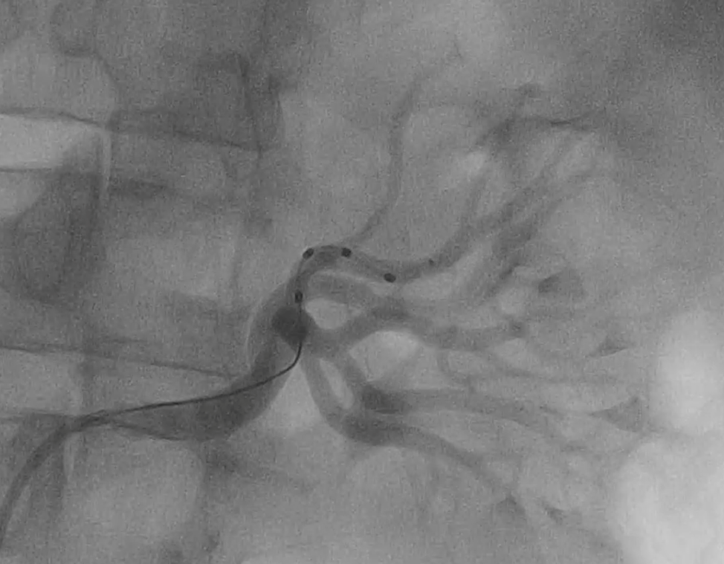
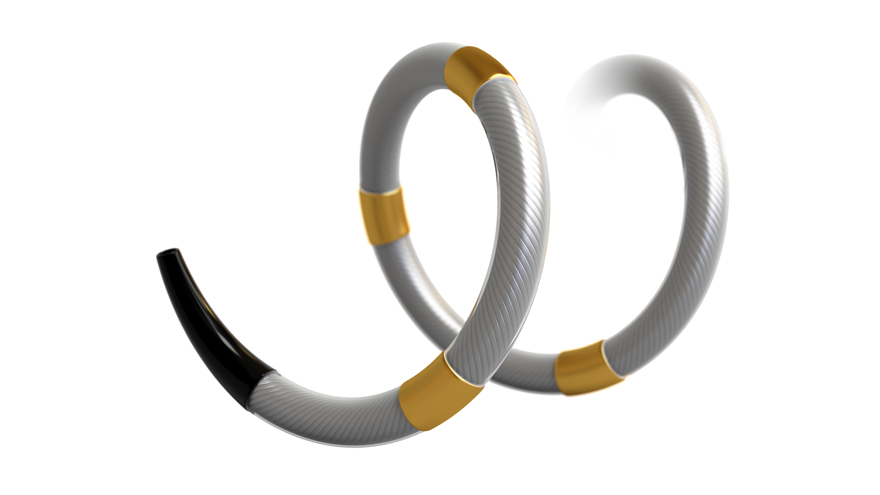
Radiofrequency Based Renal Denervation
Symplicity spiral catheter
Multi-electrode catheter with quadrantic vessel contact
Simultaneous ablation in 4 electrodes
Ablations delivery to renal main artery and branches
Notes:
The SPYRAL trial program uses radiofrequency based rernal denervation, where energy is delivery via the Symplicity Spiral catheter, which comprises of 4 electtodes with quadrantic vessel contact. With this catheter, ablations are placed either in the main renal artery or in the main and branch renal arteries. The combiend treatmemt of maon amn branch renal arteries is considered to be more effective given the fact that sympathtic nerves are closer to the lumen in the branches and therefore easier to reach.

Slide 6

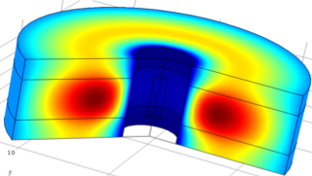
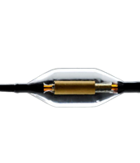
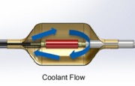
Ultrasound Based Renal Denervation
Ultrasonic Heating + Water Cooling → Thermal Profile
Paradise endovascular ultrasound ablation catheter
Ring of ablative energy (depth of 1-6 mm)
Endothelial cooling by water circulating through balloon
2-3 ablations delivered to each main renal artery
Notes:
In contrast, the RADIANCE trial program invloves ultrasound based renal denervation, where energy is delivery circular using a balloon catheter with endothelial cooling by water circulating through the balloon. With this system, 2-3 ablations a placed in each main renal artery
Whereas both technologies have been used in positive sham-controlles trials, a head-to-head comparion between different technologies and techiques is missing.

Slide 7
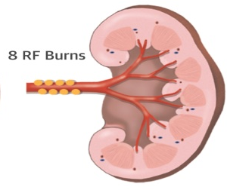
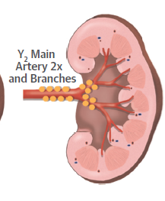
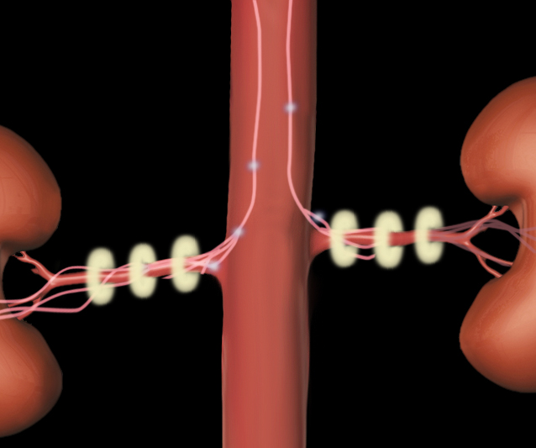
Objective
To compare the effects of renal denervation applying:
in patients with resistant hypertension.
1: Radiofrequency
main renal artery ablation
2: Radiofrequency
main and branch renal artery ablation
3: Ultrasound
main renal artery ablation
Notes:
Therefore, the aim of our trial was to compare the effects of 3. different renal denervation technologies and techniques.
1.
2.
3.
and this was done in patients wih therapy resistant hypertension!

Slide 8
Study Design – Inclusion/Exclusion
Design
Screening office BP measurements
Antihypertensive medication stable for at least 4 weeks
Design: Prospective, single-blind, single-center, three-arm randomized trial (1:1:1)
Population: Patients aged >18 or <75 years with resistant hypertension despite treatment with ≥3 drug classes at ≥50% maximum dosage including ≥1 diuretic.
Primary endpoint: Group difference of change in daytime ambulatory systolic blood pressure at 3 months
Powered to detect a 6 mmHg difference between treatment groups with 80% power
Daytime ABPM systolic ≥135 mmHg
Exclusion of secondary hypertension; lab testing for hyperaldosteronism in all; further diagnostics as appropriate
MRA, renal duplex, renal angiography
Inclusion: 1 or more renal artery ≥5.5 mm
Exclusion: stenosis, unsuitable anatomy, main artery <4mm
Radiofrequency main renal artery
Radiofrequency main and branch renal artery
Ultrasound main renal artery
Primary endpoint @ 3 months
between group difference of change in systolic daytime ABPM
Notes:
The study was design as a prospective, single-blind, single-center, three-arm randomized trial with a 1 by 1 by 1 randomization.
The Key inclusion criterion was resistant hypertension under at least 3 drugs including 1 diuretic at at leat 50% of maximum dosage
The Primary endpoint was the Group difference of change in daytime ambulatory systolic blood pressure at 3 months
and this study was Powered to detect a 6 mmHg difference between treatment groups with 80% power
Office BP measurements were only obtained initially during screening, antihypertensive medication had to be stable for at least 4 weeks
The following ABPM had to show a daytime systolic BP of 135 mmHg or more.
secondary hypertension was exclusion in all by lab testing for hyperaldosteronism with further diagnostics performed as appropriate
There wer are some morphological criteria to be met as assessment by MR angiography, rrenal duplex and invasive angiography just before the procedure,
Morphological inclusion criteria included the need for 1 or more renal artery ≥5.5 mm based on the assumpation that the distance to sympathetic nerves form the lumen and therefore branch renal artery ablation should be more of relevance in greater anatomies.
Exlcuded were those with stenosis, unsuitable anatomy or main arteries of less than 4mm
Patients werre then randomized into there groups, treated accrodingly and followed up with the primary analysis at 3 months.

Slide 9
1884 patients with elevated office blood pressure screened for eligibility
1695 excluded
555 patient or general practitioner denied
1140 had normotensive ABPM
Subject Flow
189 patients assessed for final eligibility
69 excluded
35 were considered non-adherent to medication
14 had renal artery stenosis
13 had renal artery diameter outside inclusion criteria
6 were enrolled in concurrent trial
1 had no femoral access
120 patients met final inclusion criteria
Radiofrequency main renal artery ablation, n=39
Radiofrequency combined main and branch renal artery ablation, n=39
Ultrasound main renal artery ablation, n=42
1 lost to follow-up
1 died from acute aortic
dissection after 2 months
2 lost to follow-up
1 unable to attend follow-up
1 withdrew consent
0 lost to follow-up
38 available for primary analysis
37 available for primary analysis
42 available for primary analysis
38 available for primary analysis
Notes:
This slide summarizes the subject flow, I like to highlight that for 120 patients enrolled we screend 1884 patients, most common reason for exclusion were normotensive BP on ABPM. Out of 189 eligible patients, 35 were considered non-adherent to medication and 27 did not fulfill morphological criteria
This led to 39 patients randomized to Radiofrequency main renal artery ablation, 39 to Radiofrequency combined main and branch renal artery ablation and 42 to Ultrasound main renal artery ablation. For the final analysis, data of 38, 37 and 42 patients were available.

Slide 10
Baseline Characteristics
 | RF main only (n = 39) | RF main+branches (n = 39) | Ultrasound (n = 42) | p-value
Age | 63.8 ± 9.9 | 62.1 ± 10.2 | 64.6 ± 8.0 | 0.48*
Body mass index [kg/m²] | 30.6 ± 5.4 | 31.6 ± 5.9 | 32.6 ± 5.4 | 0.27*
Female, n (%) | 13 (33) | 15 (38) | 10 (24) | 0.36†
eGFR [ml/min/1.73m²] | 79.3 ± 15.2 | 76.9 ± 18.0 | 76.2 ± 20.3 | 0.72*
Smoker, n (%) | 17 (44) | 20 (51) | 18 (43) | 0.75†
Diabetes, n (%) | 15 (38) | 18 (46) | 22 (52) | 0.59†
Peripheral arterial disease, n (%) | 3 (8) | 4 (10) | 4 (10) | 0.92†
Coronary artery disease, n (%) | 9 (23) | 15 (38) | 19 (45) | 0.11†
Previous stroke, n (%) | 2 (5) | 2 (5) | 2 (5) | 0.99†
Previous myocardial infarction, n (%) | 3 (8) | 7 (18) | 8 (19) | 0.30†
Atrial fibrillation, n (%) | 7 (18) | 6 (15) | 8 (19) | 0.91†
* p-value by ANOVA, † p-value by Pearson’s Chi Square test)
Notes:
To the results, these are the baseline charateristics, patients were around 63 years of age an eehibited a typical risk profile for hypertension with a relevant prevalence of coronary artery disease and previous myocardial infarction. There were no difference across the 3 treatment groups

Slide 11
Baseline Medications
 | RF main only (n = 39) | RF main+branches (n = 39) | Ultrasound (n = 42) | p-value
Number of antihypertensive drug classes | 4.7 ± 1.4 | 5.3 ± 1.4 | 5.0 ± 1.5 | 0.22*
Five or more drug classes, n (%) | 20 (51) | 26 (67) | 23 (55) | 0.27†
ACE-I, n (%) | 12 (31) | 13 (33) | 13 (31) | 0.96†
ARB, n (%) | 30 (77) | 25 (64) | 30 (71) | 0.46†
Renin antagonists, n (%) | 1 (3) | 2 (5) | 1 (3) | 0.75†
Beta blockers, n (%) | 34 (87) | 32 (82) | 38 (90) | 0.53†
Calcium channel blockers, n (%) | 29 (74) | 31 (79) | 31 (74) | 0.72†
Diuretics, n (%) | 38 (97) | 37 (95) | 42 (100) | 0.34†
Second diuretic, n (%) | 4 (10) | 10 (26) | 10 (24) | 0.18†
Mineralocorticoid antagonists, n (%) | 6 (15) | 12 (31) | 10 (24) | 0.27†
Vasodilators, n (%) | 2 (5) | 6 (15) | 5 (12) | 0.33†
Alpha blockers, n (%) | 9 (23) | 17 (44) | 12 (29) | 0.13†
Centrally acting sympathicolytics, n (%) | 20 (51) | 22 (56) | 15 (36) | 0.15†
* p-value by ANOVA, † p-value by Pearson’s Chi Square test)
Notes:
Patients were on an average of 5 antihypertensive drugs, so this was clearyl a therapy resistant population, There was a high rate of ACE inhibotirs and ARB across groups, more than 80% rate of Beta blocker in all groups, 75% calcium antagonist and almost 100% diuretics. there were no statistically signifikant differences in antihypertensive medication between groups.

Slide 12
Baseline Blood Pressures
 | RF main only (n = 39) | RF main+branches (n = 39) | Ultrasound (n = 42) | p-value
24 h average ABMP
Systolic | 147.4 ± 10.9 | 150.6 ± 11.4 | 151.3 ± 13.0 | 0.31*
Diastolic | 83.6 ± 10.4 | 83.5 ± 14.5 | 83.6 ± 12.5 | 0.99*
Daytime average ABMP
Systolic | 151.3 ± 12.3 | 154.2 ± 11.4 | 153.9 ± 13.6 | 0.53*
Diastolic | 86.7 ± 11.0 | 86.3 ± 15.3 | 86.0 ± 13.3 | 0.98*
Nighttime average ABMP
Systolic | 135.3 ± 13.9 | 140.3 ± 15.9 | 143.9 ± 15.9 | 0.043*
Diastolic | 73.9 ± 11.7 | 75.1 ± 15.2 | 76.7 ± 12.3 | 0.62*
Isolated systolic hypertension (%) | 20 (51) | 22 (56) | 20 (48) | 0.73†
* p-value by ANOVA, † p-value by Pearson’s Chi Square test
Notes:
Baseline systolic blood pressure on ABMP were 147 mmHg in the RF main only group, 150 mmHg in RF main and branch grouo and 151mmHg in the ultrasound group. Diastoloc pressure were about 83 mmHg in all three groups Baseline BP were well balanced between groups with the exception of nighttime systolic pressure, which were found to significantly lower in the RF main only group than in the ultrasond group
Importantly, about 50% of all patients presented with isolated systolic hypertension with with no statitical differences between groups

Slide 13
Procedural Details
 | RF main only (n = 39) | RF main+branches (n = 39) | Ultrasound (n = 42) | p-value
Right renal artery diameter [mm] | 5.7 ± 0.8 | 5.9 ± 0.7 | 5.9 ± 0.6 | 0.41*
Left renal artery diameter [mm] | 6.1 ± 0.8 | 5.9 ± 0.9 | 6.0 ± 0.7 | 0.53*
Ablation points right renal artery | 9.1 ± 3.0 | 18.3 ± 6.1 | 3.2 ± 0.8 | <0.001†
Ablation points left renal artery | 8.1 ± 2.2 | 16.8 ± 6.0 | 3.2 ± 0.9 | <0.001†
Right renal arteries treated | 1.1 ± 0.4 | 3.3 ± 0.9 | 1.0 ± 0.0 | <0.001†
Left renal arteries treated | 1.1 ± 0.2 | 3.2 ± 1.0 | 1.0 ± 0.2 | <0.001†
Contrast agent used [ml] | 90.8 ± 54.8 | 143.1 ± 66.6 | 98.7 ± 52.9 | <0.001*
Cincefluoroscopy time [min] | 8.9 ± 5.6 | 16.8 ± 8.0 | 8.1 ± 6.5 | <0.001*
* p-value by ANOVA, † p-value by Kruskal Wallis)
Notes:
Here are the procedural results: due to the inclusion criteria, renal artery dimaters were fairla large and on average 5.9 mm. There were statistical differences across groups in respect to ablation points, numer of artery treatment, contrast agent use and fluroscopy time.

Slide 14

Primary Endpoint
Group Difference of Change in Daytime Ambulatory Systolic BP at 3 Months
p<0.001
-3.2 mmHg
-6.5 mmHg
p<0.001
-6.1 mmHg
-8.3 mmHg
-7.6 mmHg
p<0.001
-13.2 mmHg
Between group difference
RF main artery vs. ultrasound
-6.7 mm Hg
(98.3% CI, -13.2 to -0.2)
Between Group Difference
RF main artery vs. Ultrasound
-4.6 mm Hg
(98.3% CI, -8.8 to -0.52)
Notes:
Now to the results of blood pressure changes: irrespective of technology and technique used, Daytime Ambulatory Systolic BP were significantly lower at 3 months as compared to baseline, with a difference of 6.5mmHg in the ....

Slide 15
Primary Endpoint
Group Difference of Change in Daytime Ambulatory Systolic BP at 3 Months
p<0.001
-3.2 mmHg
-6.5 mmHg
p<0.001
-6.1 mmHg
-8.3 mmHg
-7.6 mmHg
p<0.001
-13.2 mmHg
Between group difference
RF main artery vs. ultrasound
-6.7 mm Hg
(98.3% CI, -13.2 to -0.2)
Between Group Difference
RF main artery vs. Ultrasound
-4.6 mm Hg
(98.3% CI, -8.8 to -0.52)
Notes:
With regards to the primary endpoint, there was significant differences between the Ultrasopund grouop and the RF main renal artery group more greater blood pressure reduction in the ultrasound grouo and no significant differences of the RF main and branch group

Slide 16
Primary Endpoint
Group Difference of Change in Daytime Ambulatory Systolic BP at 3 Months
p<0.001
p<0.001
-3.2 mmHg
-6.5 mmHg
p<0.001
p<0.001
-6.1 mmHg
p<0.001
-8.3 mmHg
-7.6 mmHg
p<0.001
-13.2 mmHg
Between group difference
RF main artery vs. ultrasound
-6.7 mm Hg
(98.3% CI, -13.2 to -0.2)
Between Group Difference
RF main artery vs. Ultrasound
-4.4 mm Hg
(98.3% CI, -8.8 to -0.52)
Notes:
The diastolic BP results mirror the systolic BP results, signifikant reduction in all three group from baseline to 3 months wirth again signifikant greater BP reduction in Ultrasoiund than in RF manin renal artery only

Slide 17
Individual Patient Response @ 3 Months
Radiofrequency ablation main artery
66% responder
Ultrasound ablation main artery
Change in systolic daytime ambulatory
blood pressure (mmHg)
67% responder
Change in systolic daytime ambulatory
blood pressure (mmHg)
Radiofrequency ablation main artery + branches
73% responder
Change in systolic daytime ambulatory
blood pressure (mmHg)
Definition of response:
% Patients with
≥ 5 mm Hg Decrease
Notes:
These waterfall plots demonstraes the individual patients responses at 3 month. Importanly, the responder rate as defined by a systolic BP reduction on ABMP of at least 5 mmHg, did not differ between groups with an even numerically higher responder rate in the Radiofrequency main + branch artery group

Slide 18
Safety Data @ 3 Months
 | RF main only (n = 39) | RF main+branches (n = 39) | Ultrasound (n = 42)
Death | 1 | 0 | 0
New myocardial infarction | 0 | 0 | 0
Major bleeding | 0 | 0 | 0
New onset end stage renal disease | 0 | 0 | 0
Serum creatinine elevation >50% | 0 | 0 | 0
Embolic events | 0 | 0 | 0
Vascular complications | 1 | 1 | 1
Hospitalization for hypertensive crisis | 0 | 1 | 0
New stroke | 0 | 0 | 0
New renal artery stenosis > 70% | 0 | 0 | 0
Notes:
In term of safety, therr were very few events within the study period. Unfortunetaly, there was one death due to aortic dissection 2 months after the procedure in the RF main group. retrospectve evaluation of angiographies did not reveal any procedural complication or dissection at the time of the procedure in this patient.
All all groups, there was 1 vascular complication with could be treated conservatively with sequelae in all 3 patients.
1 hypertensives crisis
No renal artery stenosis were seen at 3 month FU assessment!

Slide 19
Limitations
Single-center and relatively small number of patients for a three-arm study design
Study endpoint at 3 months, while data from SPYRAL-HTN-ON-MED suggest
later response at 6 months
Number of ablations in main and branch artery group lower than in SPYRAL HTN ON/OFF
Inclusion of patients with isolated systolic hypertension
Long-term effects on safety, specifically effects on the renal arteries unknown
No drug testing to inform on drug adherence
Inclusion of patients with larger renal arteries only (based on the assumption that sympathetic fibers are in greater distance from the lumen than in smaller arteries and therefore renal branch artery ablation or higher penetration depth more relevant).

Slide 20
Conclusion
Renal denervation effectively lowered blood pressure in resistant hypertension
All three denervation techniques/technologies exhibited favourable safety profile
Endovascular ultrasound based renal denervation was superior to radiofrequency ablation of the main renal arteries
The differences in magnitude of blood pressure reduction did not translate into better responder rates
Longer follow up and larger, multi-center studies investigating different renal denervation technologies and techniques are needed to determine long term safety as well as efficacy
This pilot study precludes definite recommendations regarding the preferable renal denervation approach

Slide 21
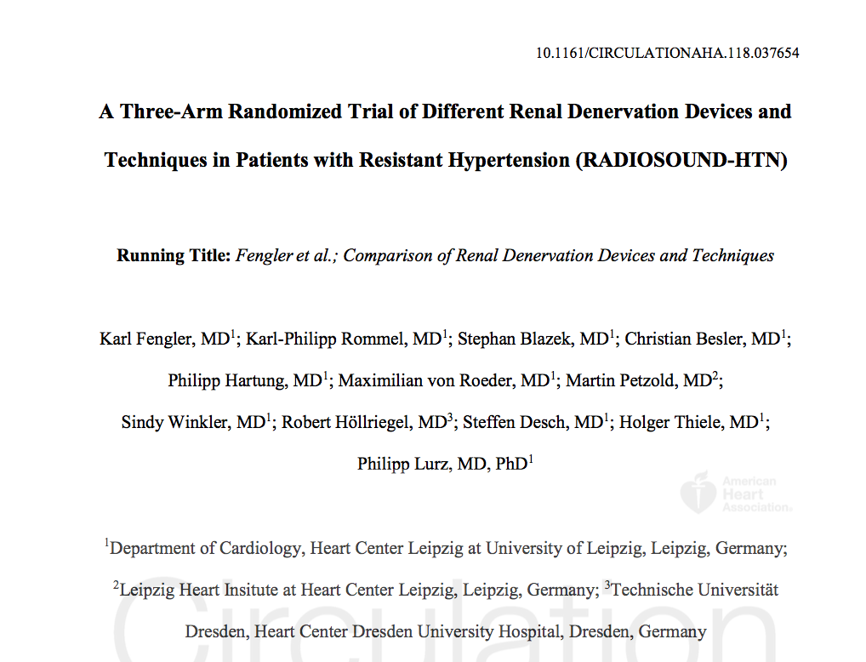
Simultaneous Publication in Circulation

