Slide 1
ULTIMATE
A Multicenter, Prospective, Randomized Trial
Comparing Intravascular Ultrasound-guided versus Angiography-guided Implantation of
Drug-Eluting Stent in All-comers
Jun-Jie Zhang, MD, PhD
Xiaofei Gao, Jing Kan, Zhen Ge, Leng Han, Shu Lu, Nailiang Tian, Song Lin, Qinghua Lu Xueming Wu, Qihua Li, Zhizhong Liu, Yan Chen, Xuesong Qian, Juan Wang, Dayang Chai, Chonghao Chen, Xiaolong Li, Bill D. Gogas, Tao Pan, Shoujie Shan, Fei Ye, Shao-Liang Chen
NCT02215915
Notes:
Nanjing Heart Center
Nanjing First Hospital

Slide 2
Disclosure Statement of Financial Interest
I, (Jun-Jie Zhang) DO NOT have a financial interest/arrangement or affiliation with one or more organizations that could be perceived as a real or apparent conflict of interest in the context of the subject of this presentation.

Slide 3
Background
Both randomized and observational studies have reported the clinical advantages of IVUS guidance for patients who have complex lesions.
The benefits of IVUS guidance over angiography guidance in all-comers who receive 2nd generation DES implantation still remain understudied.
Notes:
2
This is the Bulleted List slide.
To create this particular slide, click the NEW SLIDE button on your toolbar and choose the BULLETED LIST format. (Top row, second from left)
The Sub-Heading and footnote will not appear when you insert a new slide. If you need either one, copy and paste it from the sample slide.
If you choose not to use a Sub-Heading, let us know when you hand in your presentation for clean-up and we’ll adjust where the bullets begin on your master page.
Also, be sure to insert the presentation title onto the BULLETED LIST MASTER as follows:
Choose View / Master / Slide Master from your menu.
Select the text at the bottom of the slide and type in a short version of your presentation title.
Click the SLIDE VIEW button in the lower left hand part of your screen to return to the slide show. (Small white rectangle)

Slide 4
Study Design
1448 all-comer patients
1:1 Randomization
IVUS guidance
(n=724)
Angiography guidance
(n=724)
Primary endpoint: TVF at 12 months

Slide 5
Major Inclusion Criteria
Silent ischemia, Stable angina or unstable angina
Acute myocardial infarction >24 h
De novo lesion
Notes:
Inclusion criteria included patients who had silent ischemia, stable or unstable angina,
or myocardial infarction (MI, including both ST-elevation and non-ST-elevation MI) > 24 h from the onset of chest pain to admission,
and de novo coronary lesion eligible for DES implantation.

Slide 6
Major Exclusion Criteria
Life expectancy <12 months
Intolerant of DAPT
CTO not re-canalized
Severe calcification needing rotational atherectomy

Slide 7
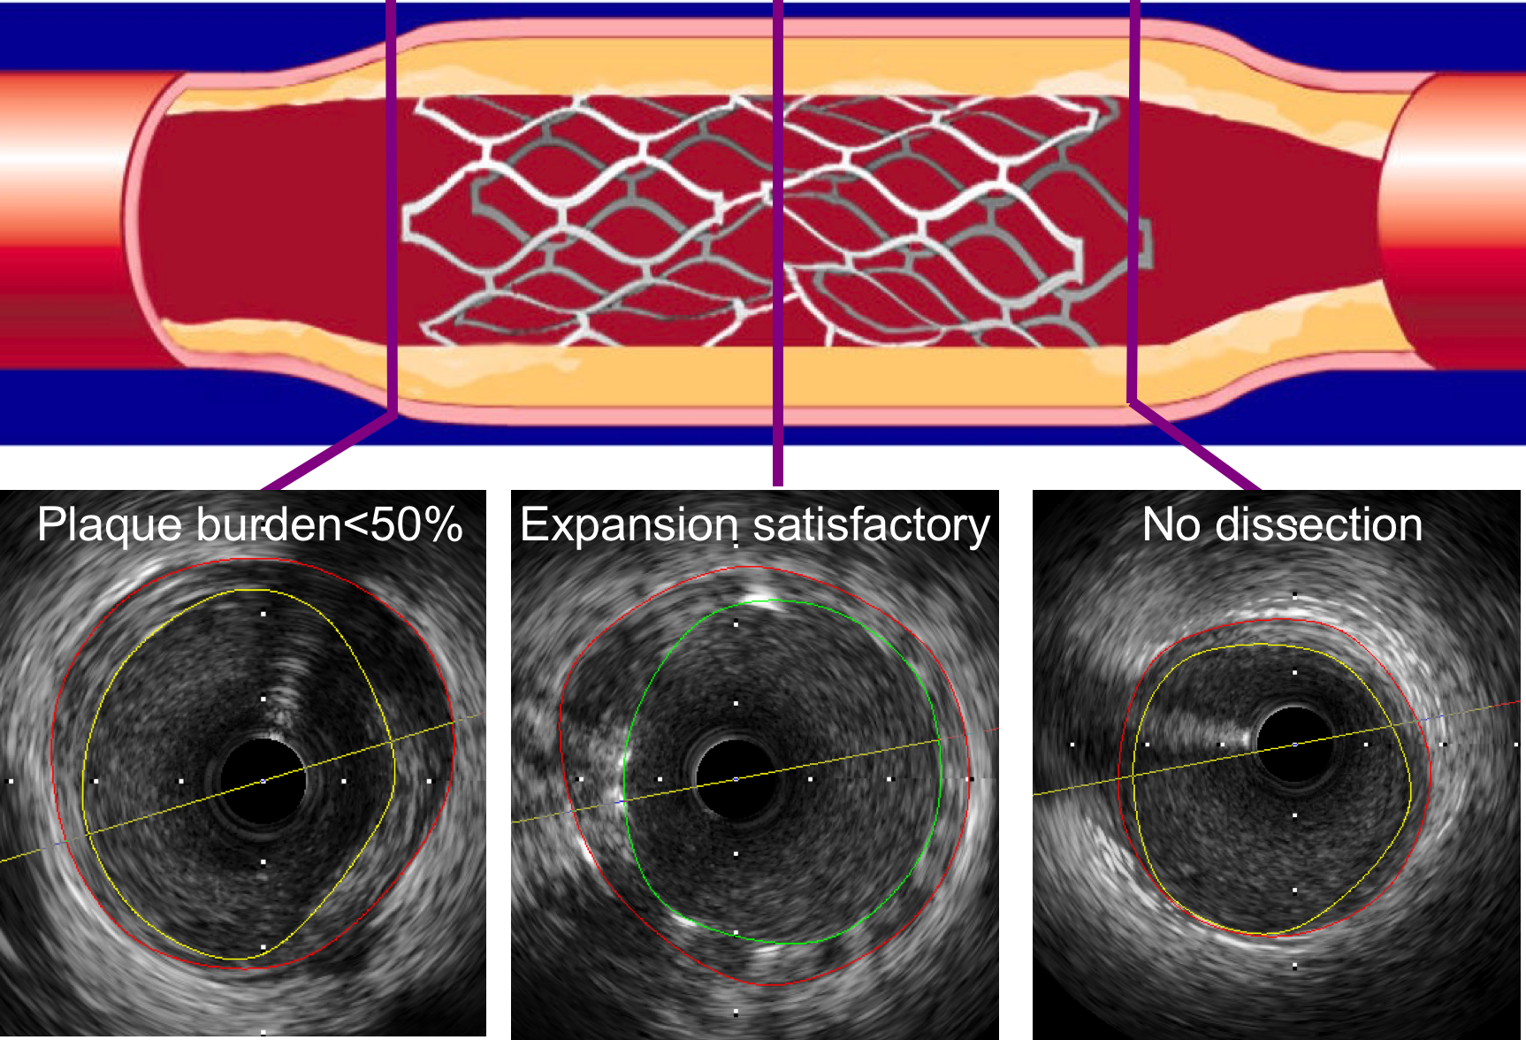
IVUS-defined Criteria for The
Optimal Stent Deployment
  Minimal lumen CSA in stented segment >5.0 mm², or 90% of distal reference lumen CSA;
  Plaque burden at the 5-mm proximal or distal to the stent edge <50%;
  no edge dissection involving media with length >3mm.
Notes:
IVUS-defined optimal PCI was accepted only if those three criteria were simultaneously achieved.
Otherwise, the PCI procedure defined as suboptimal if any of those three criteria was not met.

Slide 8
Endpoints
Endpoints | Timing of follow-up | Powered for
Primary composite endpoint
TVF | 12 months | Superiority
Secondary endpoints
CD, TVMI, TVR, TLR separately | 12 months | -
Safety endpoints
Definite/probable ST | 12 months | -
Notes:
Protocol-defined periprocedural MI (within 72 h) was defined as creatine kinase-myocardial band (CK-MB) >10 times the upper reference limit (URL) of the assay, or >5 times URL plus either:
new pathological Q waves in >2 contiguous leads or new left bundle branch block;
or 2) angiographically documented graft or coronary artery occlusion or new severe stenosis with thrombosis;
or 3) imaging evidence of new loss of viable myocardium or new regional wall motion abnormality.

Slide 9
Sample Size Calculation
IVUS guidance
Angiography guidance
1-year TVF
Prior studies
2.8-3.1%
6.0-6.5%
Conservative
assumption
2.9%
6.1%
80% power with a 2-sided alpha of 0.05
N=658 pts/group, 10% lost = total 1448 pts
Notes:
We hypothesized that the rate of a 1-year TVF would be 2.9% in the IVUS guidance group and 6.1% in the Angiography guidance group based on previous studies (9, 12-14). Accordingly, a total of 1316 patients were needed to detect a power of 0.8 (Type II error = 0.2, 𝛼 = 0.05, 2-tailed). Because of the considerable uncertainty of patients lost to follow-up, the enrollment was extended to 1448 patients (10% increment).

Slide 10
Enrollment
1795 all-comers from Aug 2014 to May 2017
347 patients excluded
261 refused to participate
86 met exclusion criteria
1448 all-comers from 8 Chinese centers
1:1 Randomization
IVUS guidance
(n=724)
Angiography guidance
(n=724)
8 patients crossover
3 CTO lesions
2 LM lesions
1 rupture plaque
1 diffused lesion
1 calcified lesion
4 patients lost to FU with 2 in each group
Clinical FU at 12-mo
(n=722)
Clinical FU at 12-mo
(n=722)
Notes:
The most common reasons for not enrolling were inconvenience (including PCI in bad time, insufficient technicians to perform on-site measurements, no sufficient time because of too many cases daily), unreimbursed by medicare, and a 40-MHz mechanical transducer (Boston Scientific Corporation, Natick, MA, USA) unavailable.

Slide 11
Baseline Clinical Data
 | IVUS guidance (n=724) | Angiography guidance (n=724) | P
Age | 65.2±10.9 | 65.9±9.8 | 0.19
Male | 73.9% | 73.2% | 0.77
Hypertension | 70.7% | 72.0% | 0.60
Diabetes | 30.0% | 31.2% | 0.61
Current smoker | 34.9% | 31.5% | 0.16
UAP | 67.4% | 64.4% | 0.22
AMI | 11.2% | 14.0% | 0.11
LVEF, % | 60.9±7.9 | 60.3±9.3 | 0.19

Slide 12
Core Lab Lesions Data (I)
 | IVUS guidance (n=962) | Angiography guidance (n=1016) | P
Lesion location |  |  | 0.51
LM | 9.9% | 8.6%
LAD | 47.5% | 46.7%
LCX | 17.3% | 16.8%
RCA | 25.4% | 28.0%

Slide 13
Core Lab Lesions Data (II)
 | IVUS guidance (n=962) | Angiography guidance (n=1016) | P
Multi-vessel disease | 52.6% | 57.2% | 0.08
B2/C | 66.1% | 67.7% | 0.45
Bifurcation | 23.5% | 26.5% | 0.13
CTO | 8.8% | 9.0% | 0.93
Moderate to severe calcification | 25.3% | 24.2% | 0.59

Slide 14
Procedural Data (I)
 | IVUS guidance (n=724) | Angiography guidance (n=724) | P
Per patient, n (%)
Stent number | 2.40±1.55 | 2.47±1.56 | 0.39
Mean stent length, mm | 66.42±46.17 | 66.49±44.36 | 0.98
Mean stent diameter, mm | 3.15±0.42 | 2.99±0.38 | <0.001
Max balloon diameter, mm | 3.84±0.52 | 3.62±0.51 | <0.001
Max Post-dilation pressure, atm | 19.8±3.7 | 19.2±3.6 | 0.003

Slide 15
Procedural Data (II)
 | IVUS guidance (n=962) | Angiography guidance (n=1016) | P
Per lesion, n (%)
Stent number | 1.81±0.80 | 1.76±0.77 | 0.16
Mean stent length, mm | 49.99±25.10 | 47.38±22.42 | 0.02
Mean stent diameter, mm | 3.14±0.51 | 2.97±0.48 | <0.001
Max balloon diameter, mm | 3.73±0.56 | 3.51±0.53 | <0.001
Max post-dilation pressure, atm | 19.7±3.7 | 19.0±3.7 | <0.001

Slide 16
Procedural Data (III)
 | IVUS guidance (n=724) | Angiography guidance (n=724) | P
Radial access | 94.8 | 96.8 | 0.07
2nd generation DES | 99.2% | 98.8% | 0.44
Post-dilation | 96.6% | 94.9% | 0.11
Procedural time, min | 60.88 | 45.49 | <0.001
Contrast volume, ml | 178.29 | 161.96 | <0.001
CIN | 7.9% | 5.8% | 0.12
Complete revas. | 73.3% | 75.0% | 0.47
Angiographic success | 98.0% | 97.8% | 0.77

Slide 17
Clinical Outcomes
 | IVUS guidance (n = 724) | Angiography guidance (n = 724) | P
Primary endpoint at 30-day
TVF | 0.8% | 1.9% | 0.08
Primary endpoint at 12-month
TVF | 2.9% | 5.4% | 0.019
Cardiac death | 0.7% | 1.4% | 0.19
TVMI | 1.0% | 1.5% | 0.34
Clinically-driven TVR | 1.5% | 2.9% | 0.07
Safety endpoint at 12-month
Definite/probable ST | 0.1% | 0.7% | 0.10

Slide 18
Primary Endpoint
TVF at 12 months

Slide 19
Secondary Endpoint
CD-TLR or Definite ST at 12 months
From Lesion-level

Slide 20
On-line IVUS assessment
 | Optimal group | Suboptimal group | P
Number of patients, n (%) | 384 (53.0) | 340 (47.0)
Number of lesions, n (%) | 578 (60.1) | 384 (39.9)
MSA, mm² | 6.09 | 5.45 | <0.001
Prox. edge plaque burden | 37.2% | 51.2% | <0.001
Dist. edge plaque burden | 24.2% | 35.1% | <0.001

Slide 21
Optimal vs. Suboptimal IVUS-guided PCI
TVF at 12 months
Notes:
patients with ACS or multivessel disease might benefit from IVUS guidance (Online Figure 2). Patients who met the optimal criteria had a lower rate of TVF at 12 months (1.6%), compared to that in patients who had a suboptimal PCI procedure (4.4%; HR 0.349; 95% CI 0.135-0.898; p=0.029, Central Illustration).

Slide 22
Limitations
Three IVUS criteria were simultaneously used to define optimal PCI, which could underestimate the advantages of IVUS usage.
We did not directly compare the rate of TVF stratified by different IVUS-defined criteria.
lesion-level analysis was underpowered because only TLR and definite ST (secondary endpoints) were able to be calculated from sample size.
Longer-term follow up (through 5 years) is required

Slide 23
Conclusion
In the present multicenter randomized trial, IVUS-guided DES implantation in all-comers resulted in lower incidence of TVF at 12 months, compared with angiography guidance, particularly for patients who had an IVUS-defined optimal procedure.

Slide 24
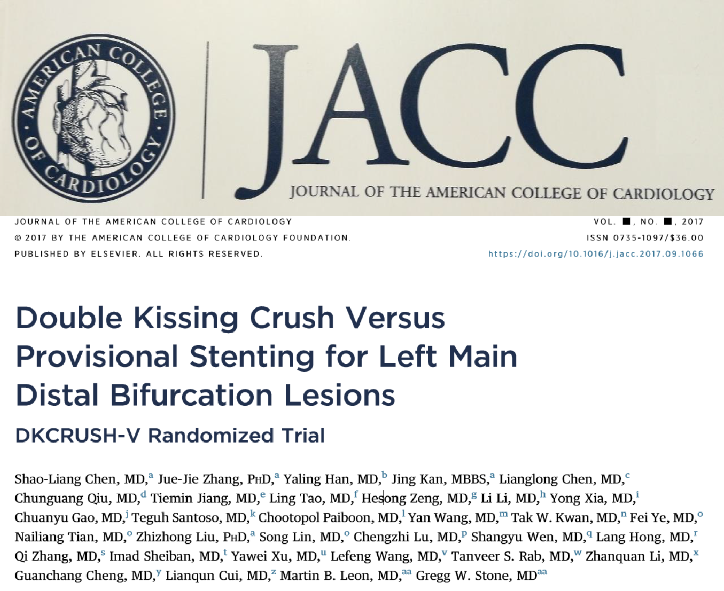
Accepted for Publication

Slide 25
Thanks for Your Attention

